Slide 1
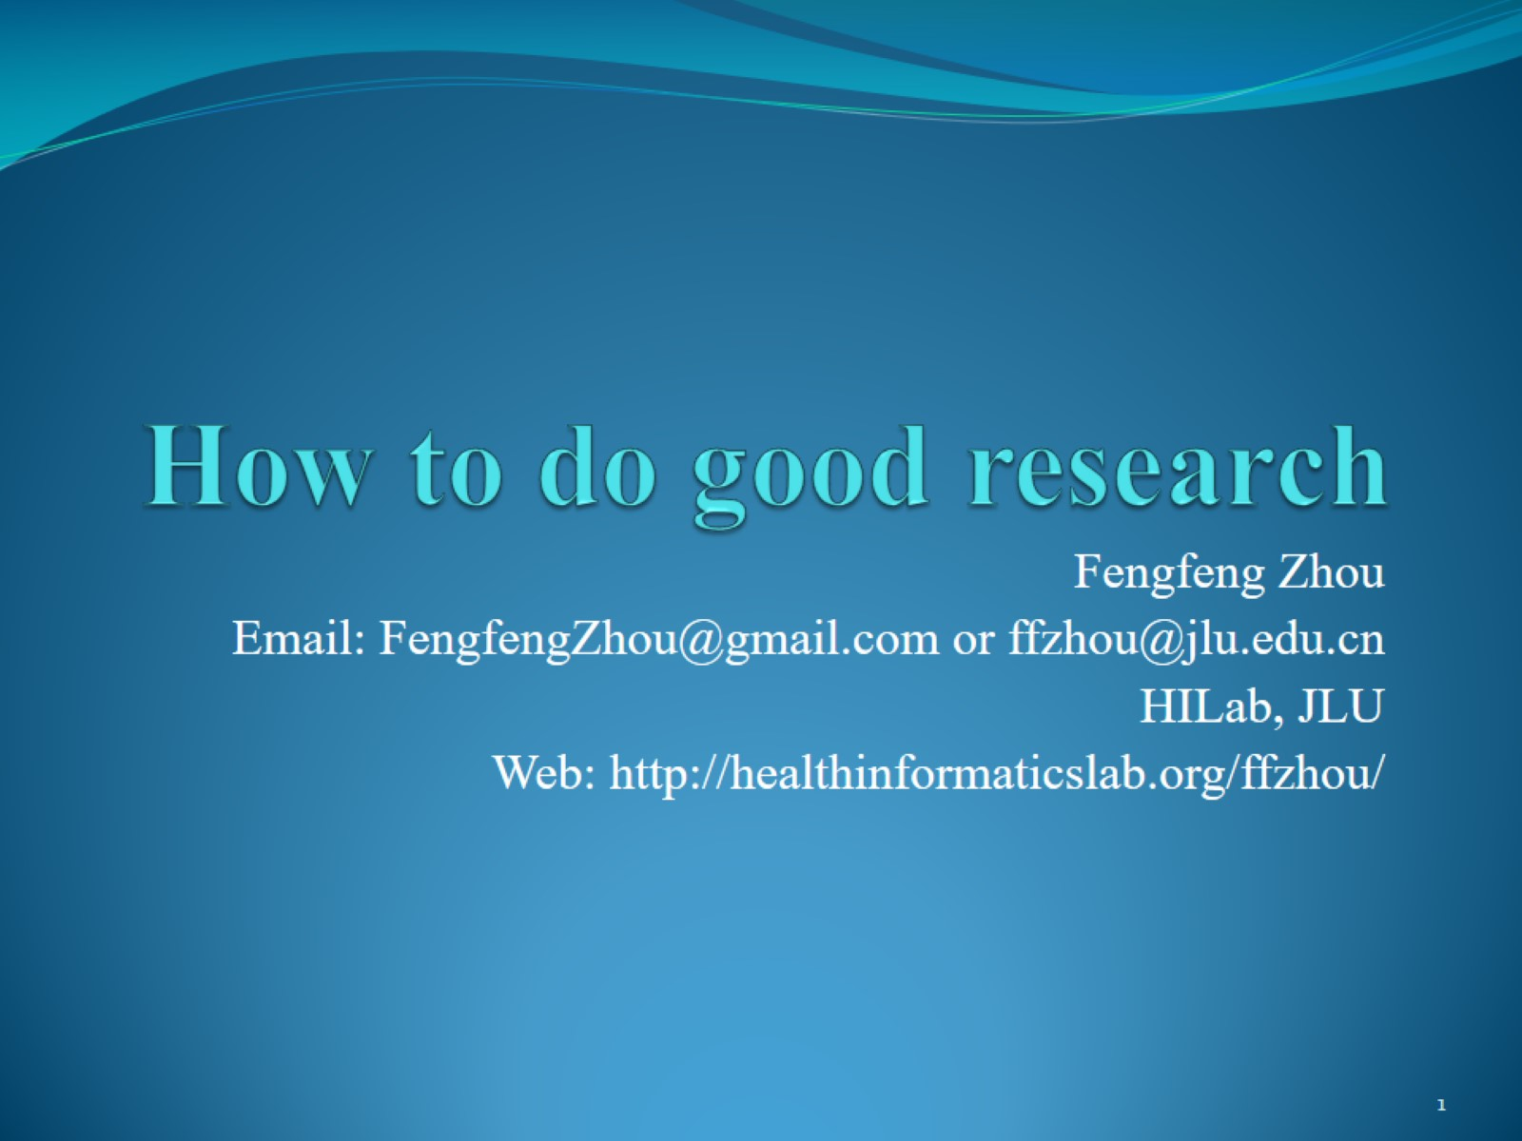
How to do good research

Slide 2
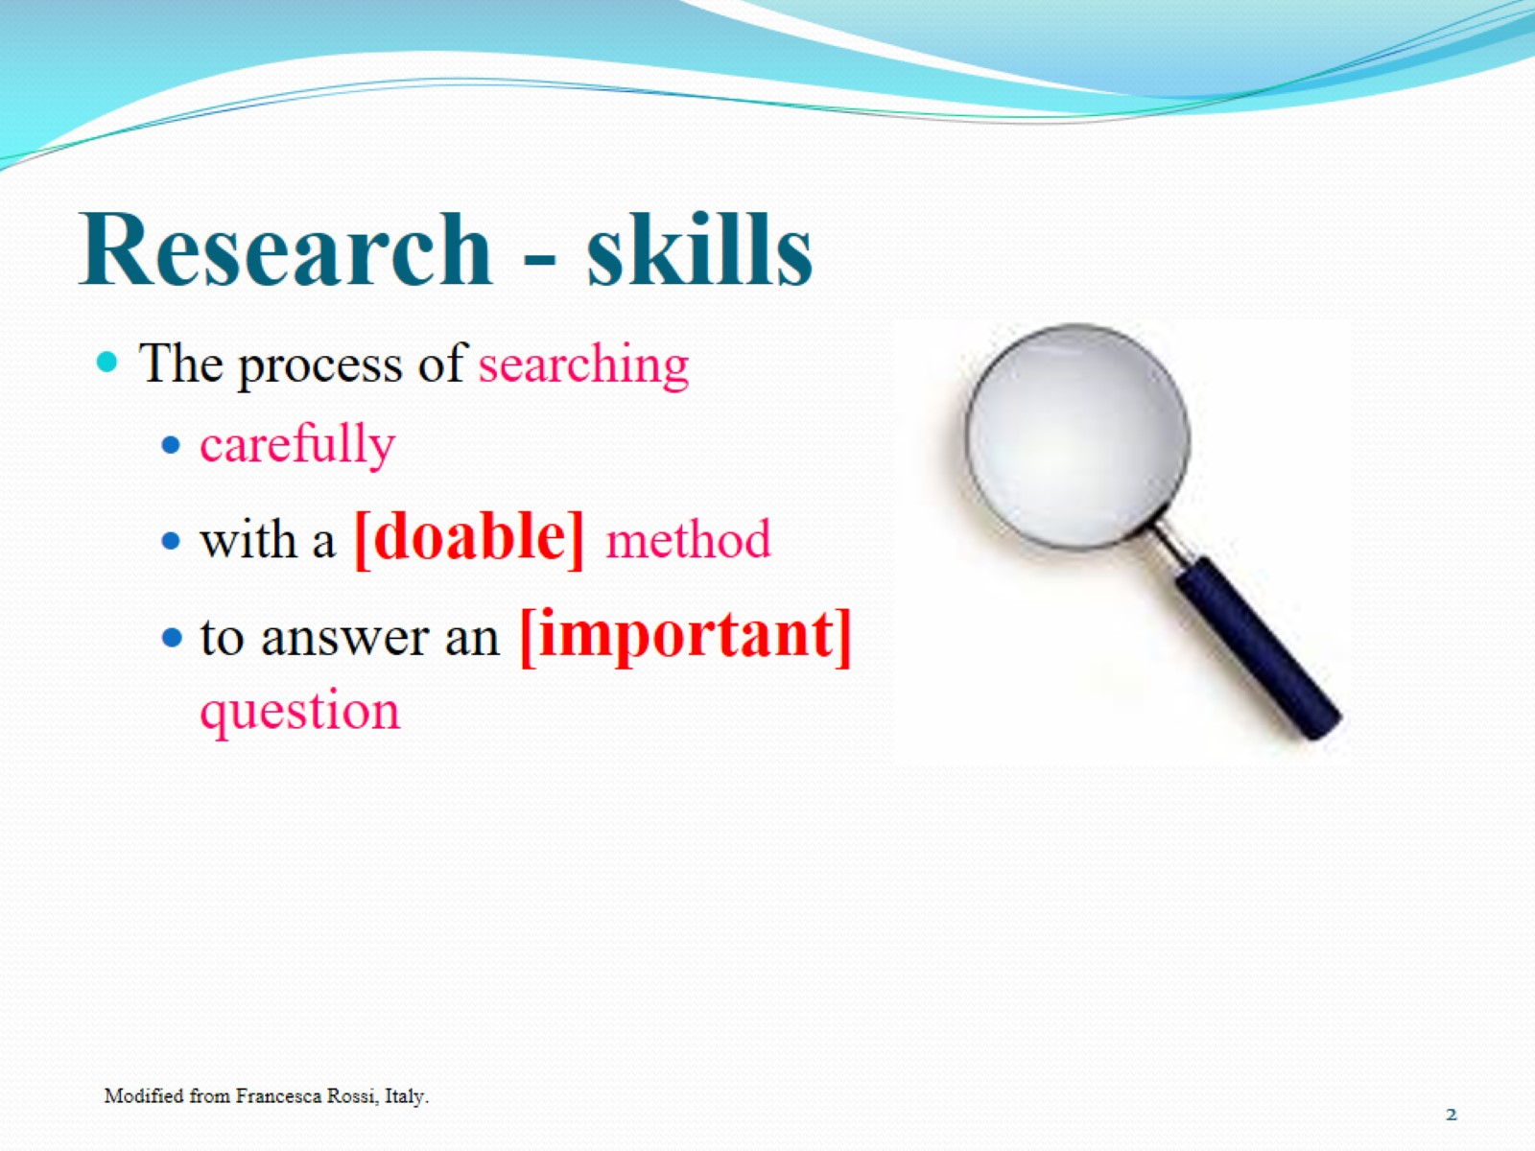
Research - skills

Slide 3
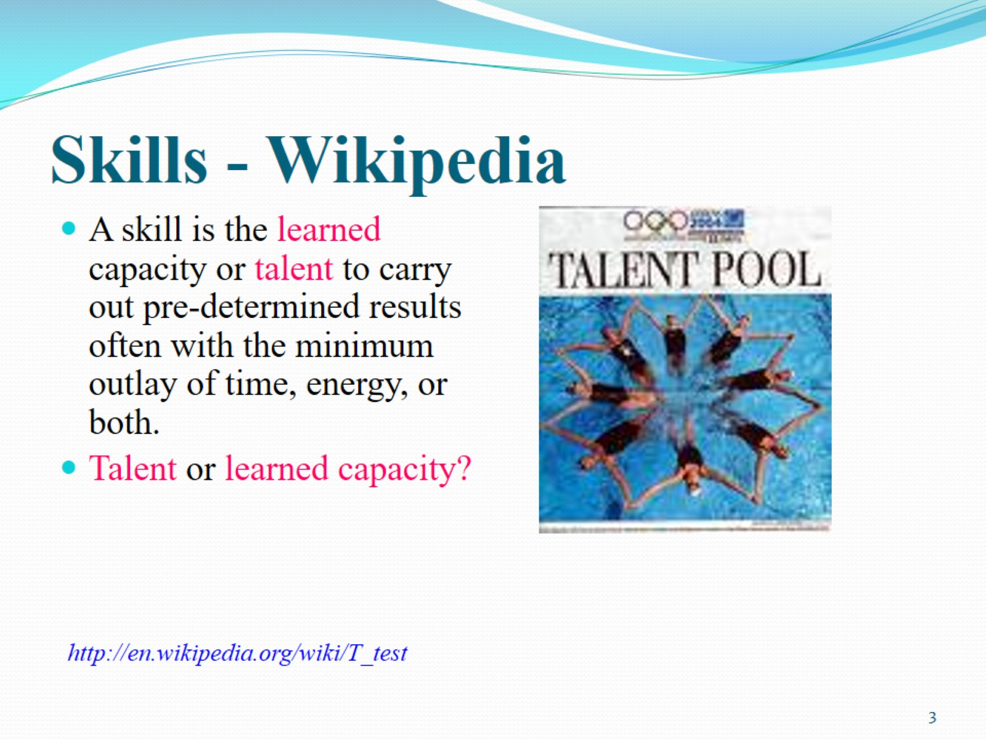
Skills - Wikipedia

Slide 4
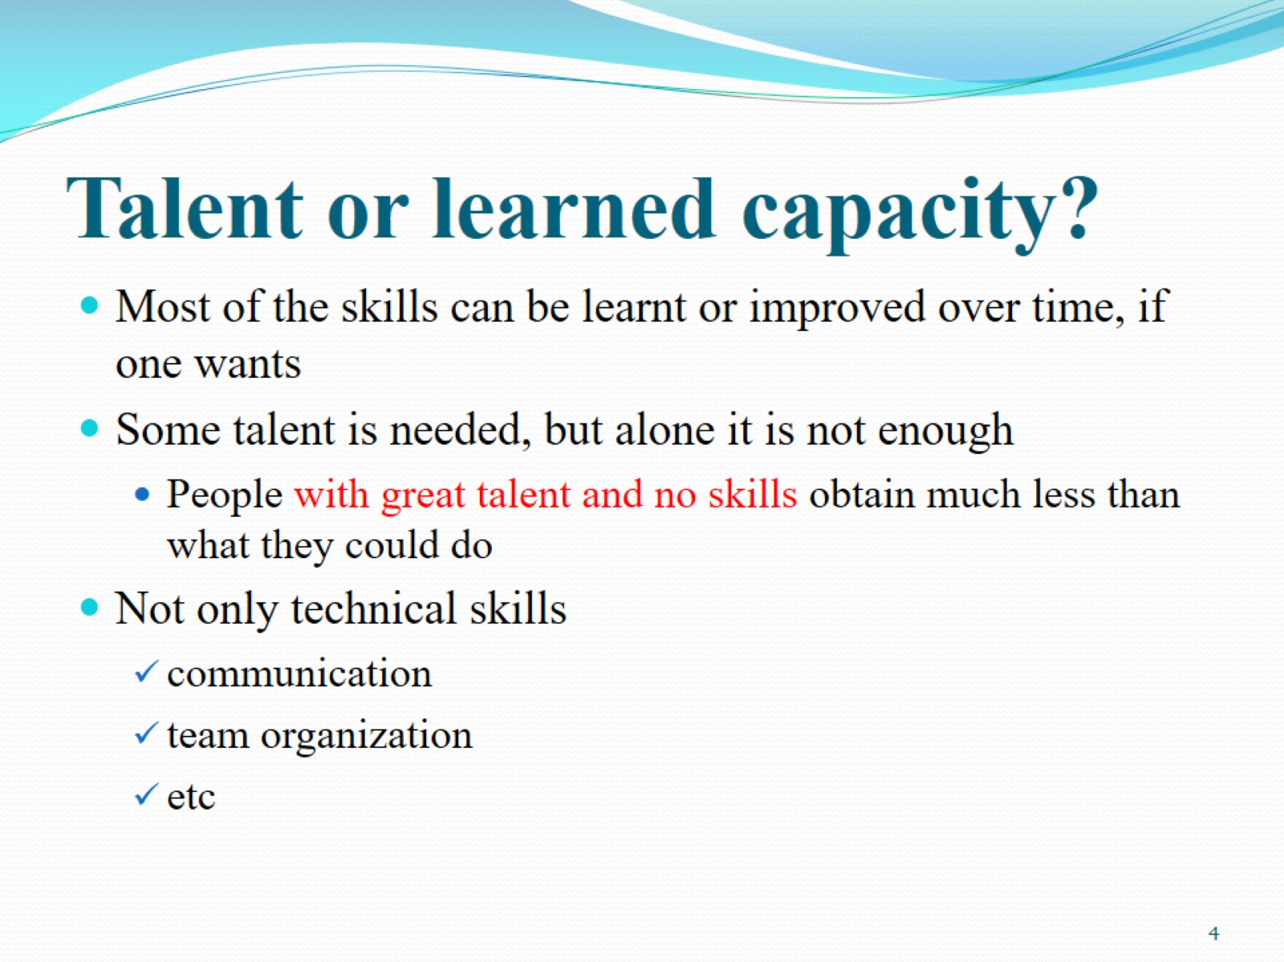
Talent or learned capacity?

Slide 5
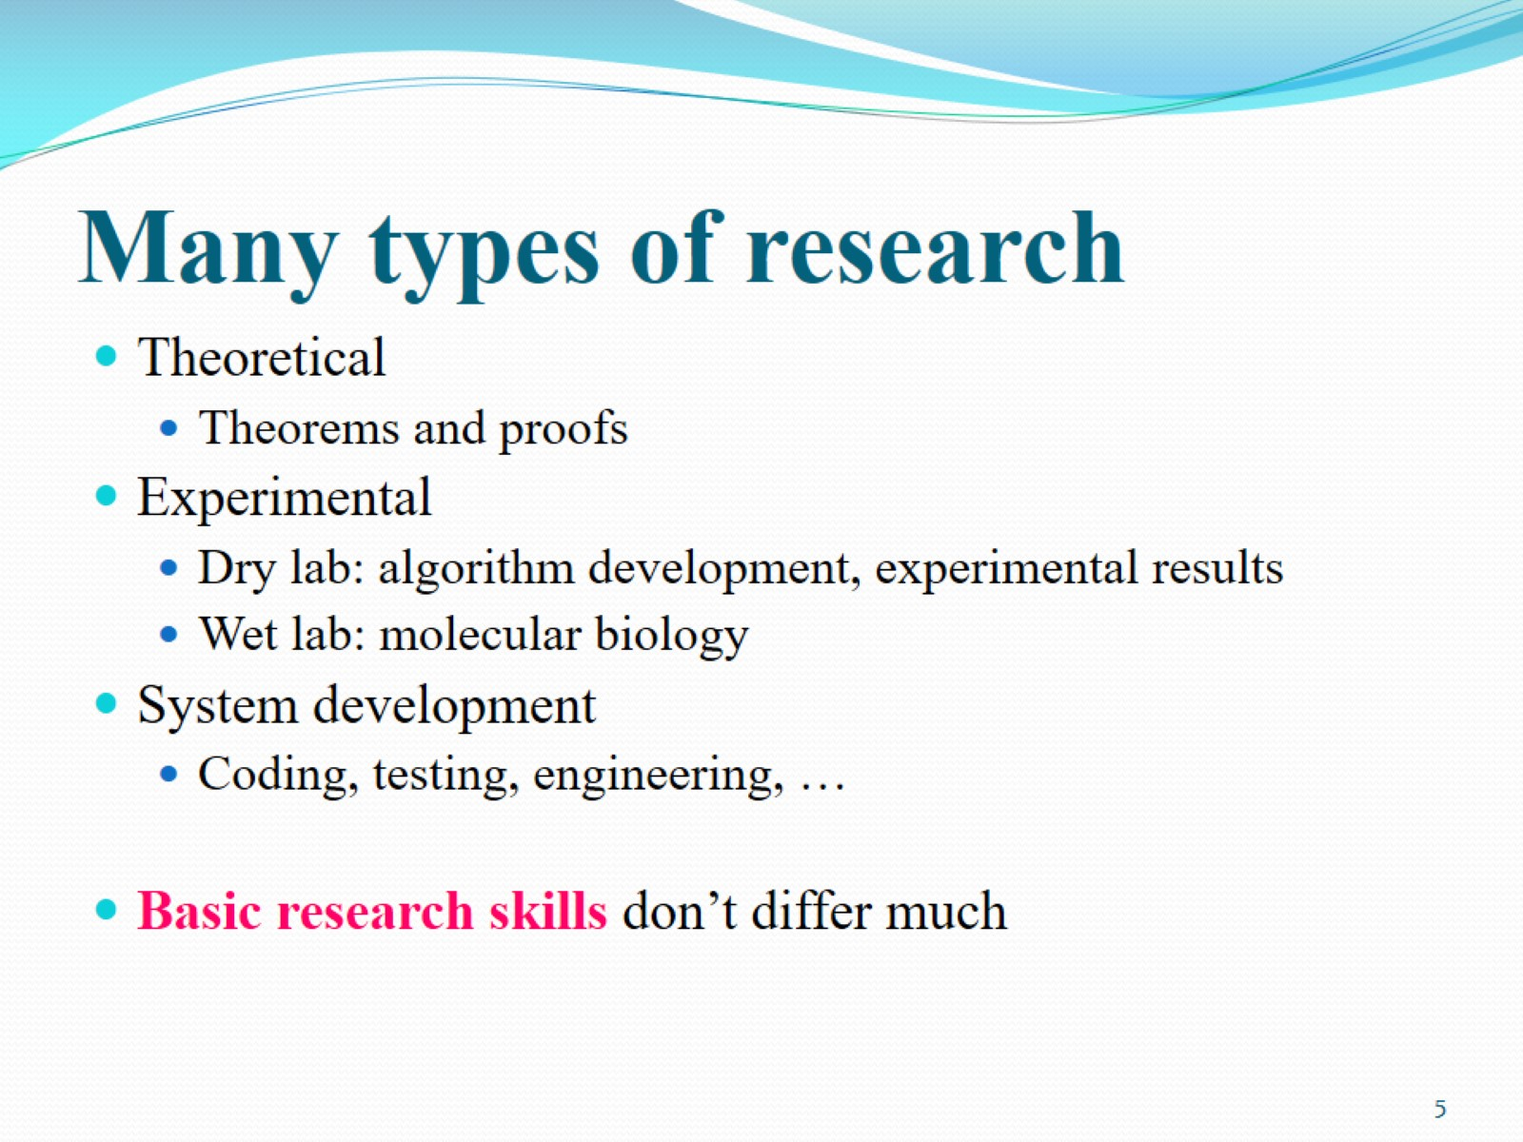
Many types of research

Slide 6
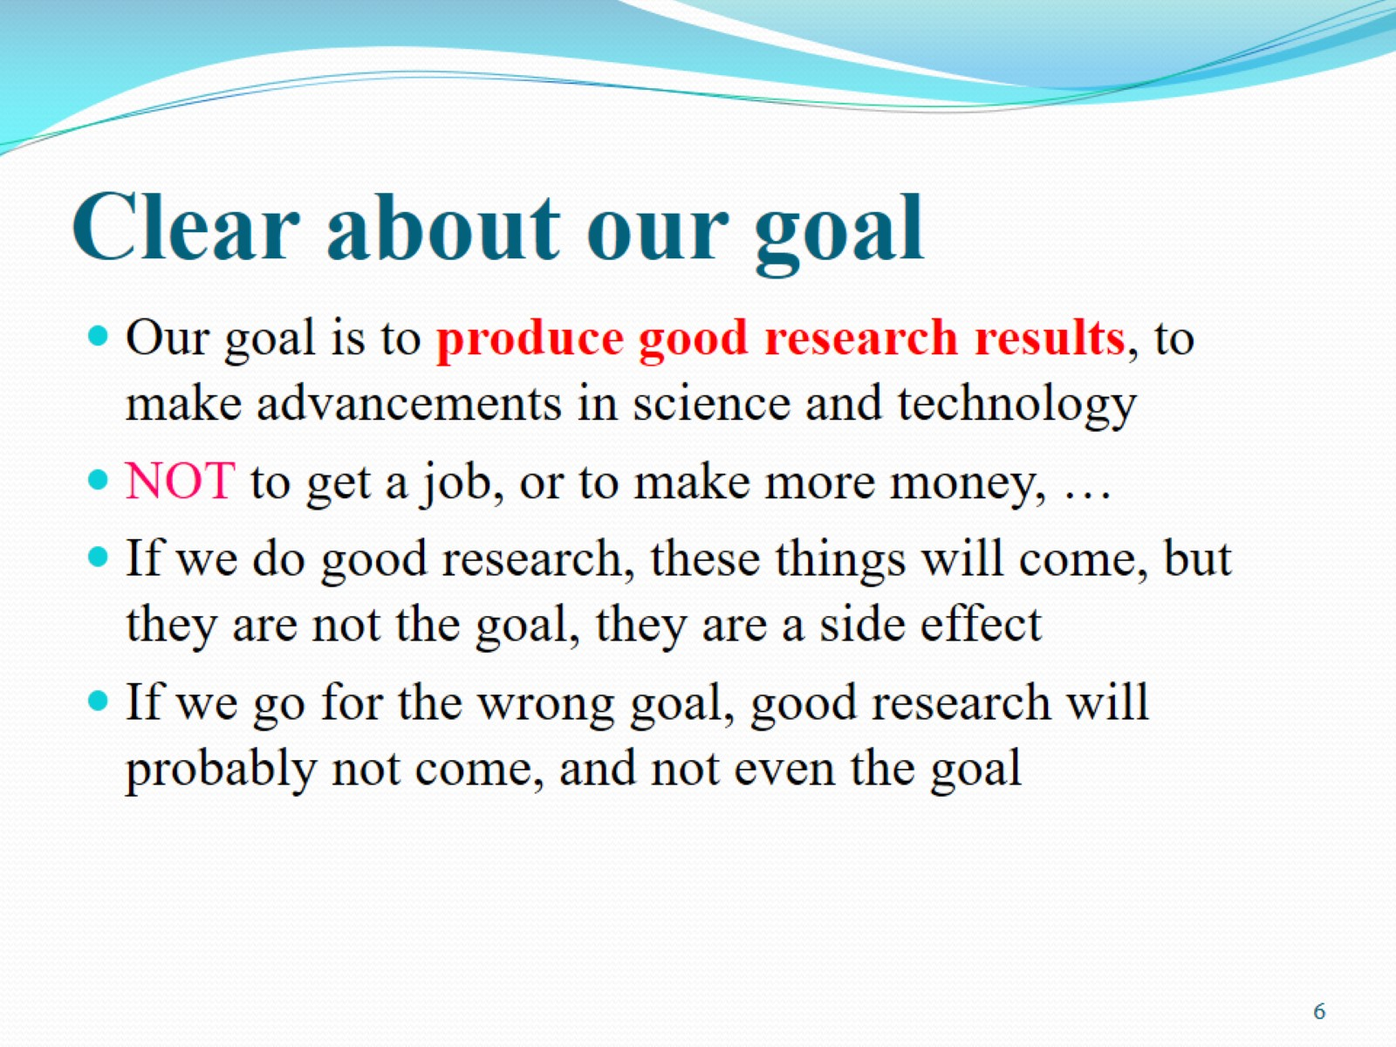
Clear about our goal

Slide 7
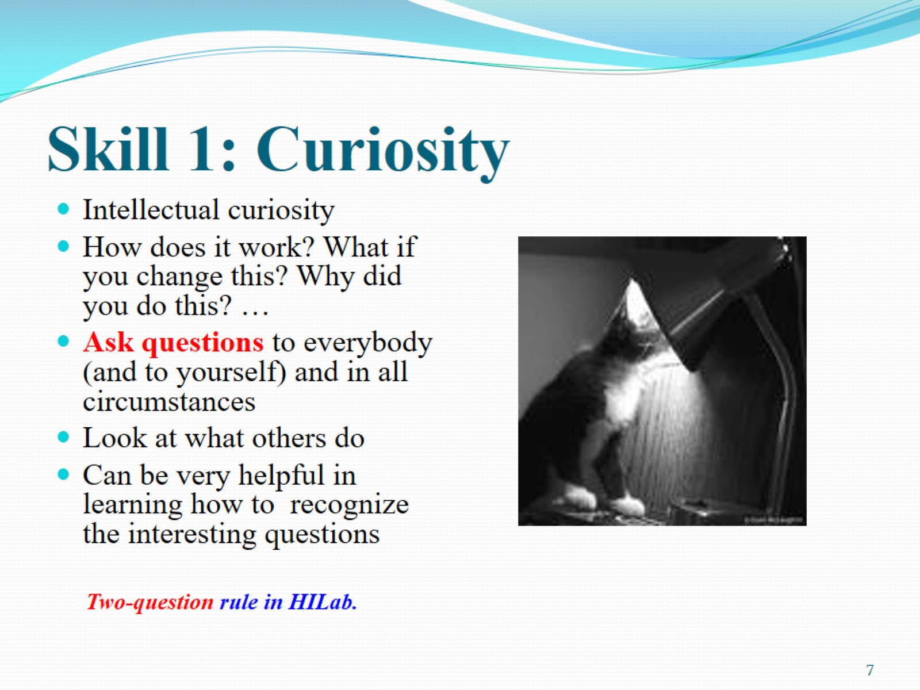
Skill 1: Curiosity

Slide 8
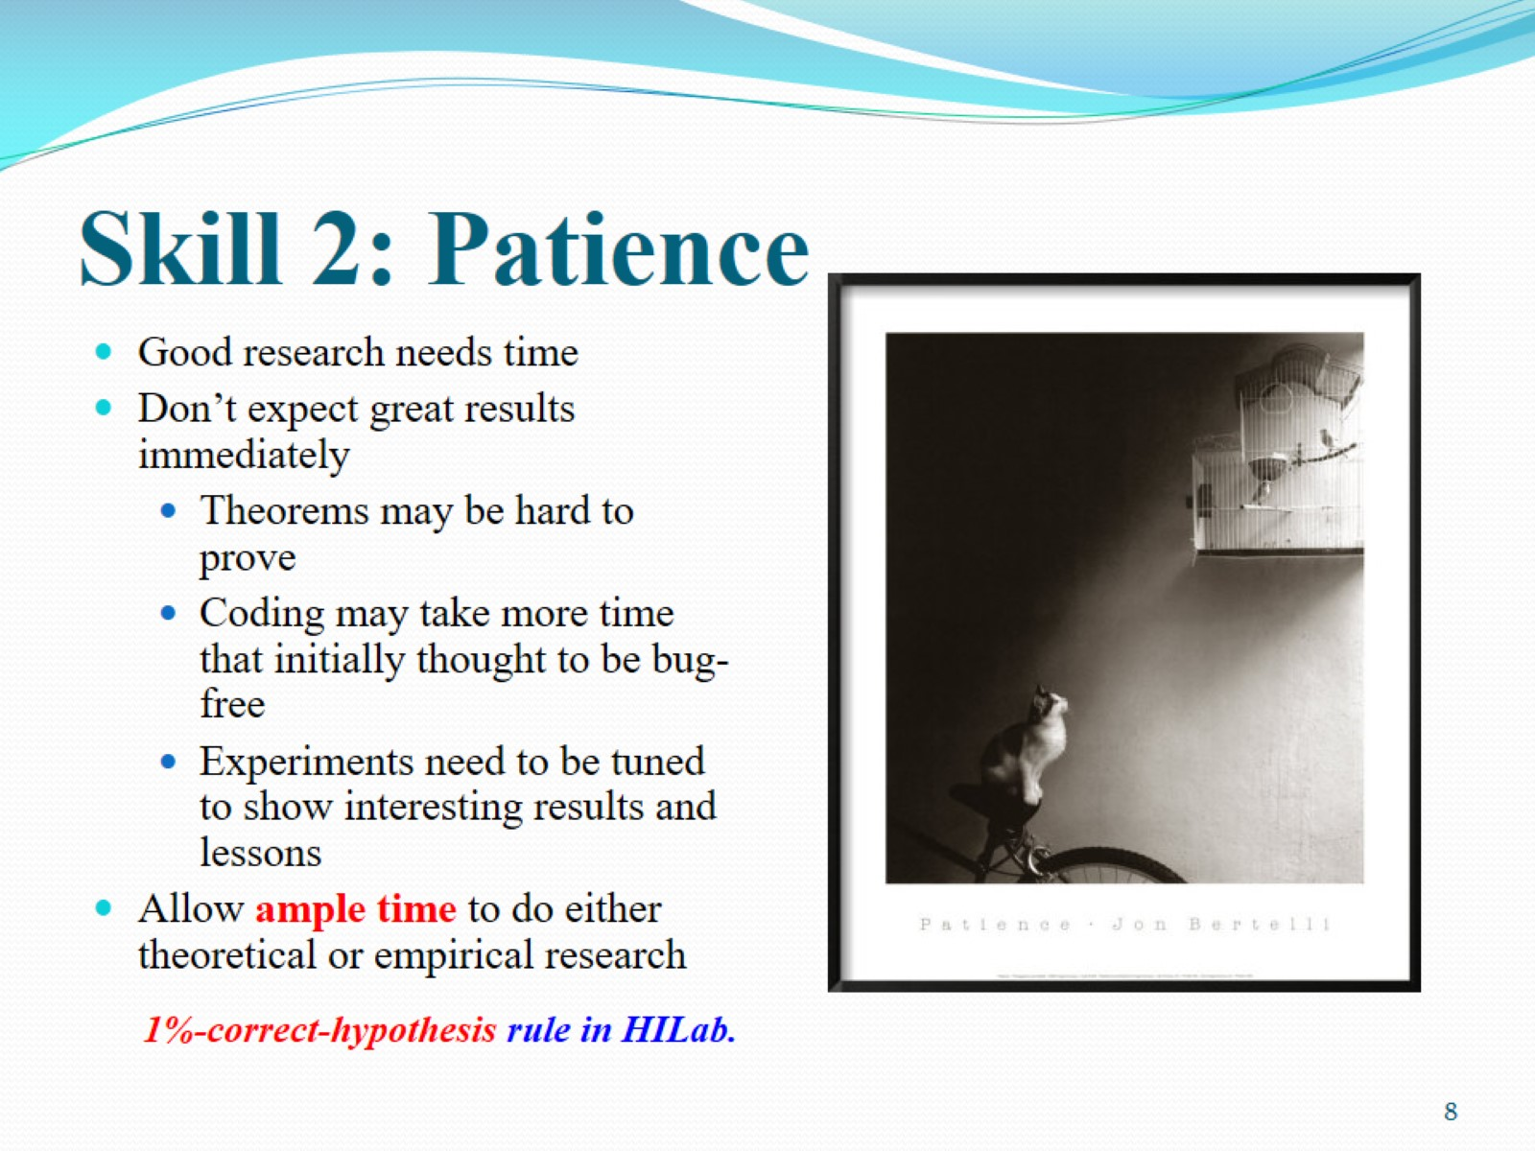
Skill 2: Patience

Slide 9
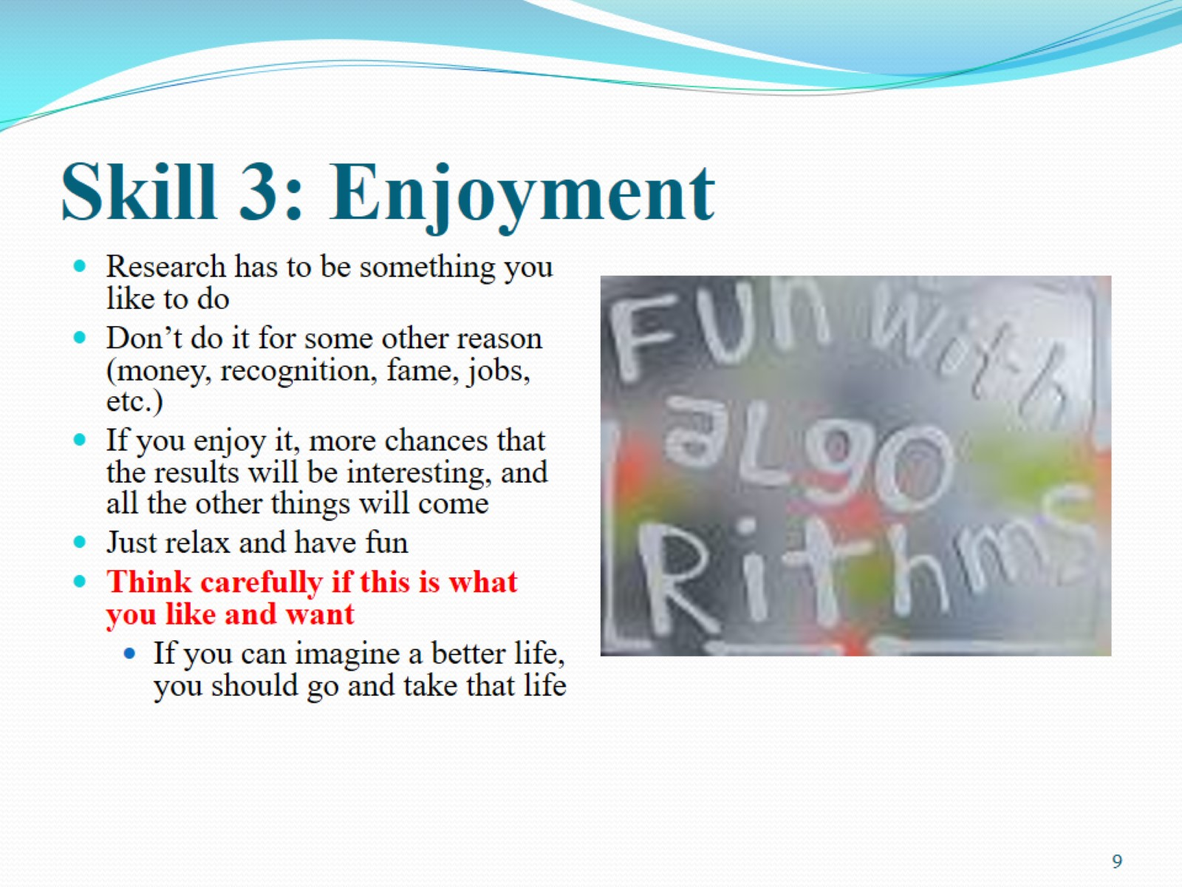
Skill 3: Enjoyment

Slide 10
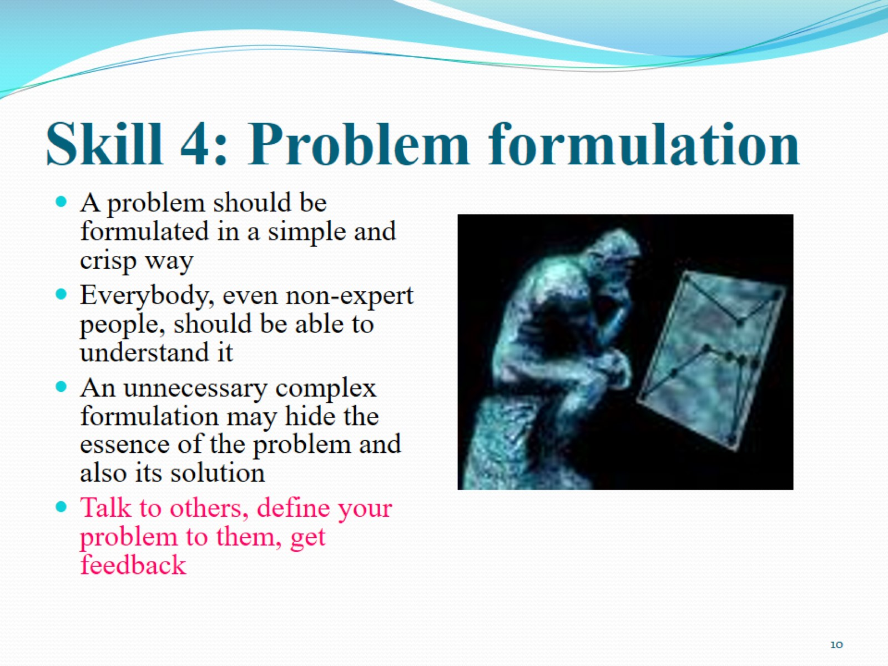
Skill 4: Problem formulation

Slide 11
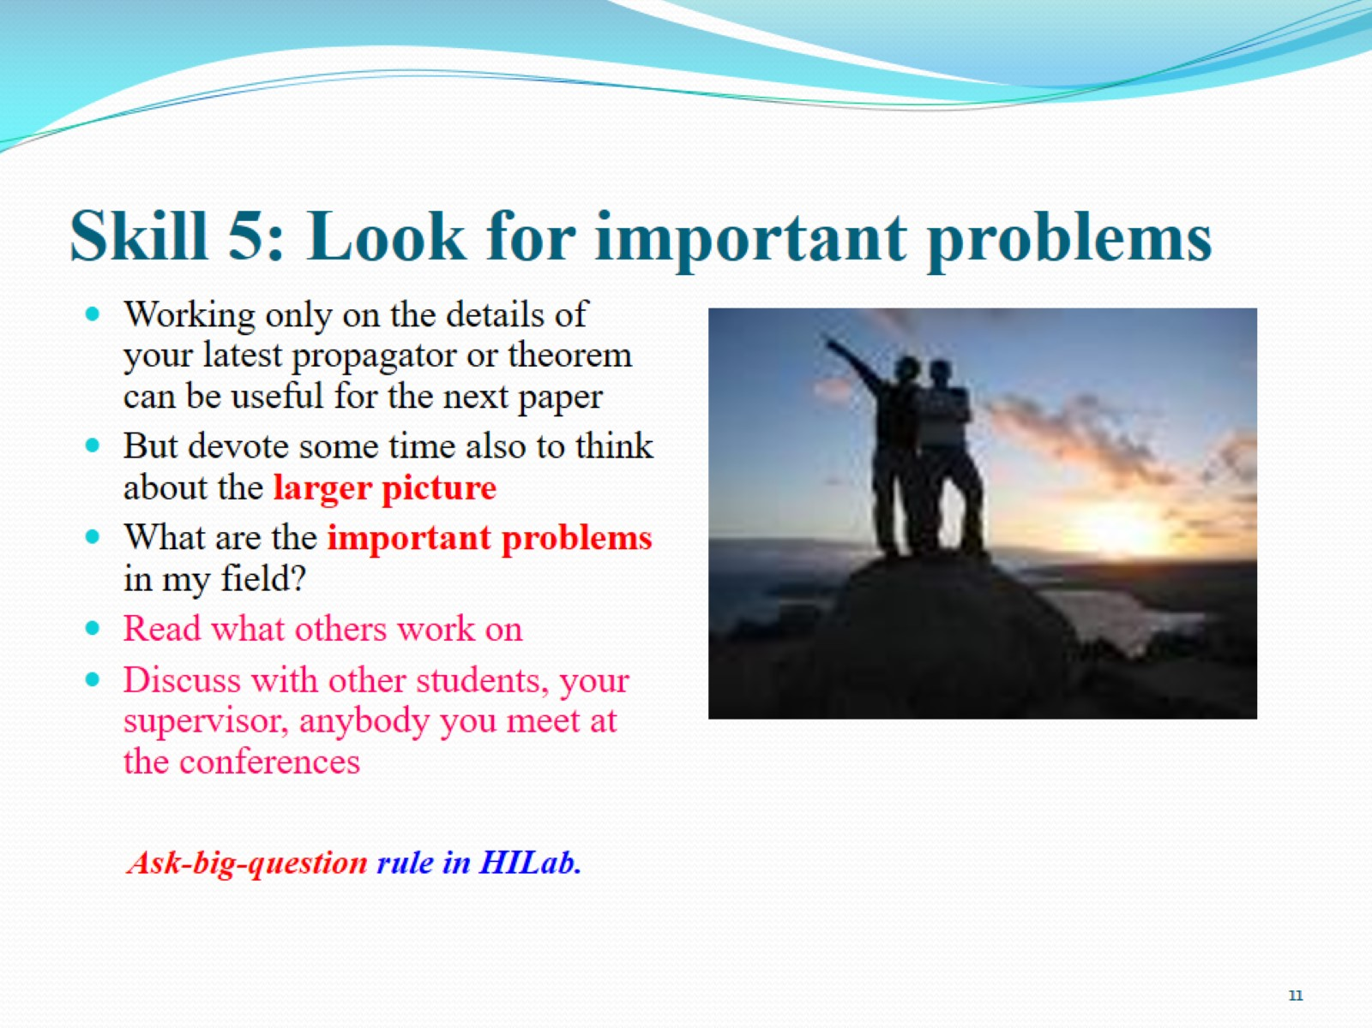
Skill 5: Look for important problems

Slide 12
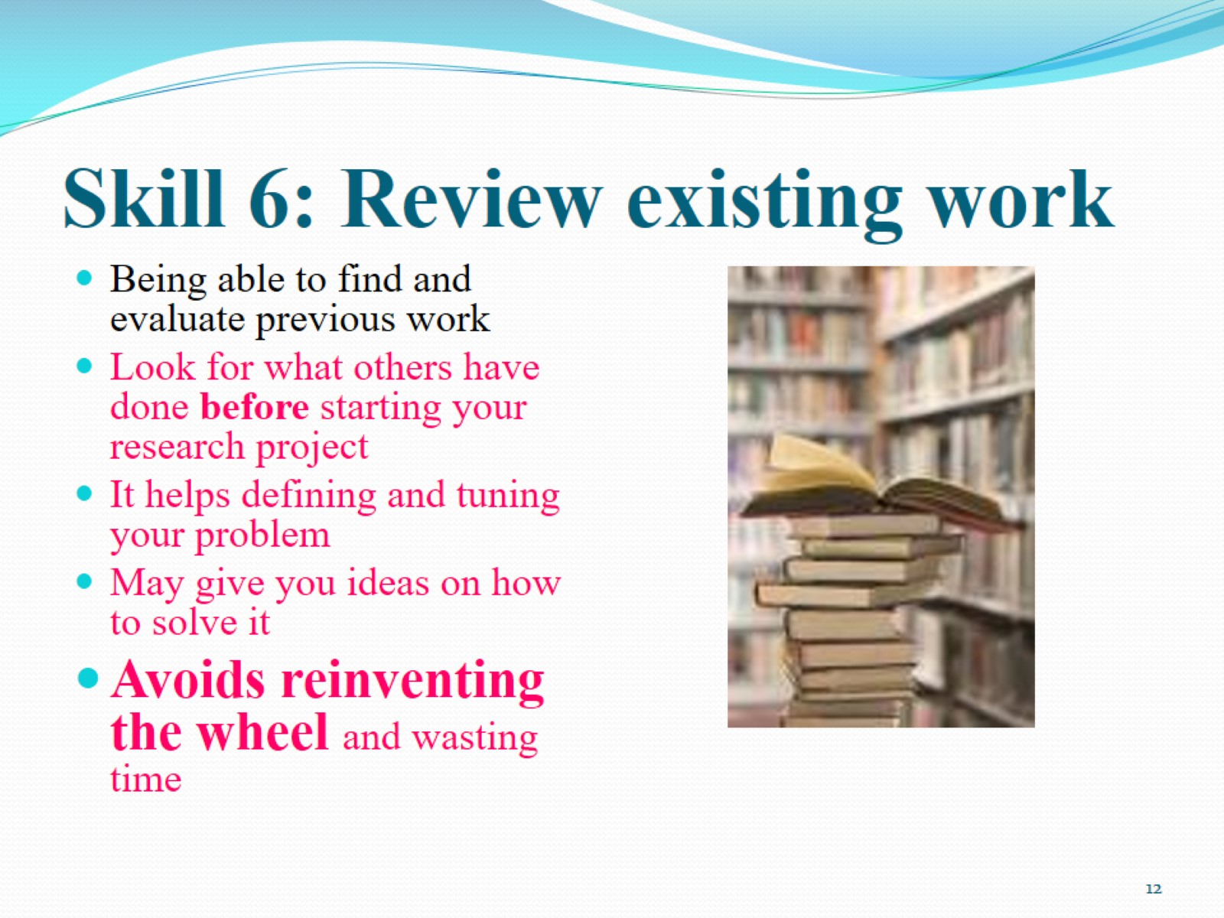
Skill 6: Review existing work

Slide 13
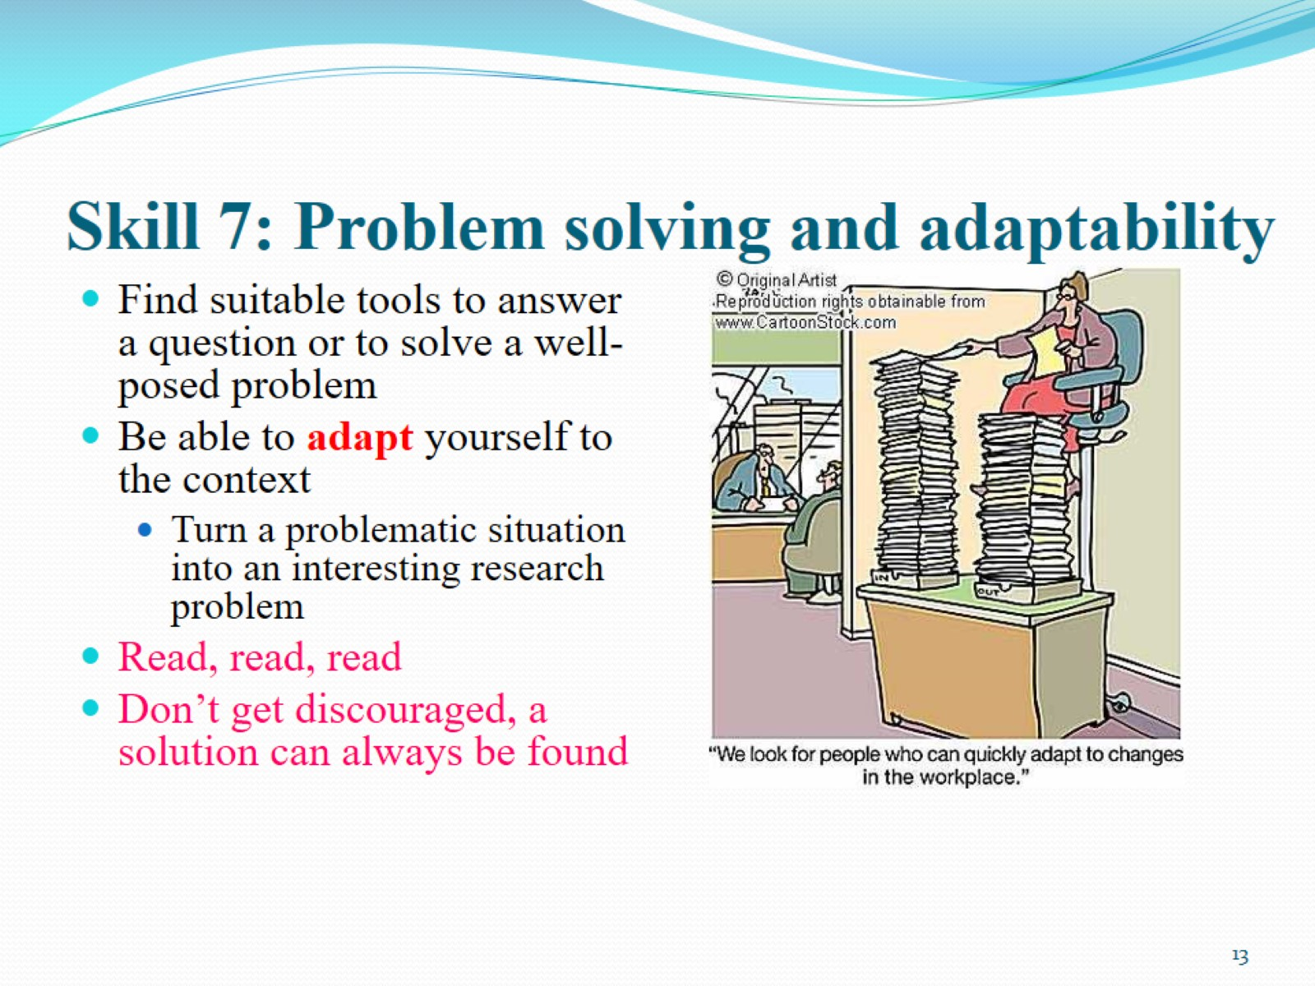
Skill 7: Problem solving and adaptability

Slide 14
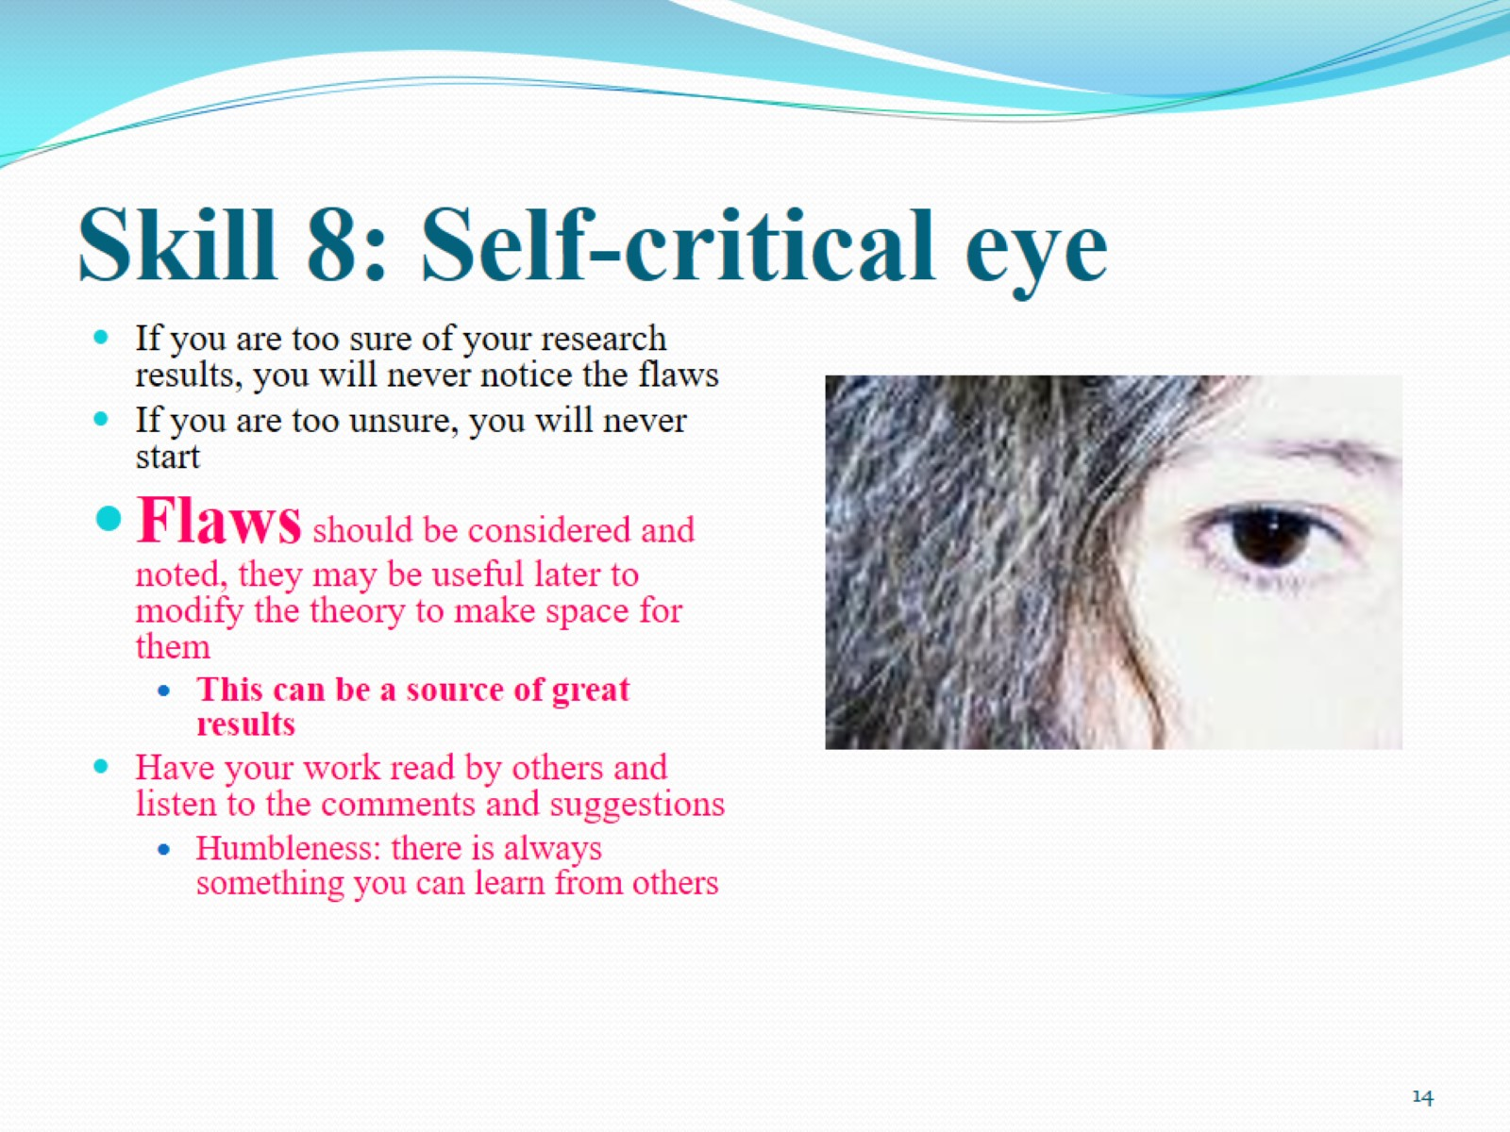
Skill 8: Self-critical eye

Slide 15
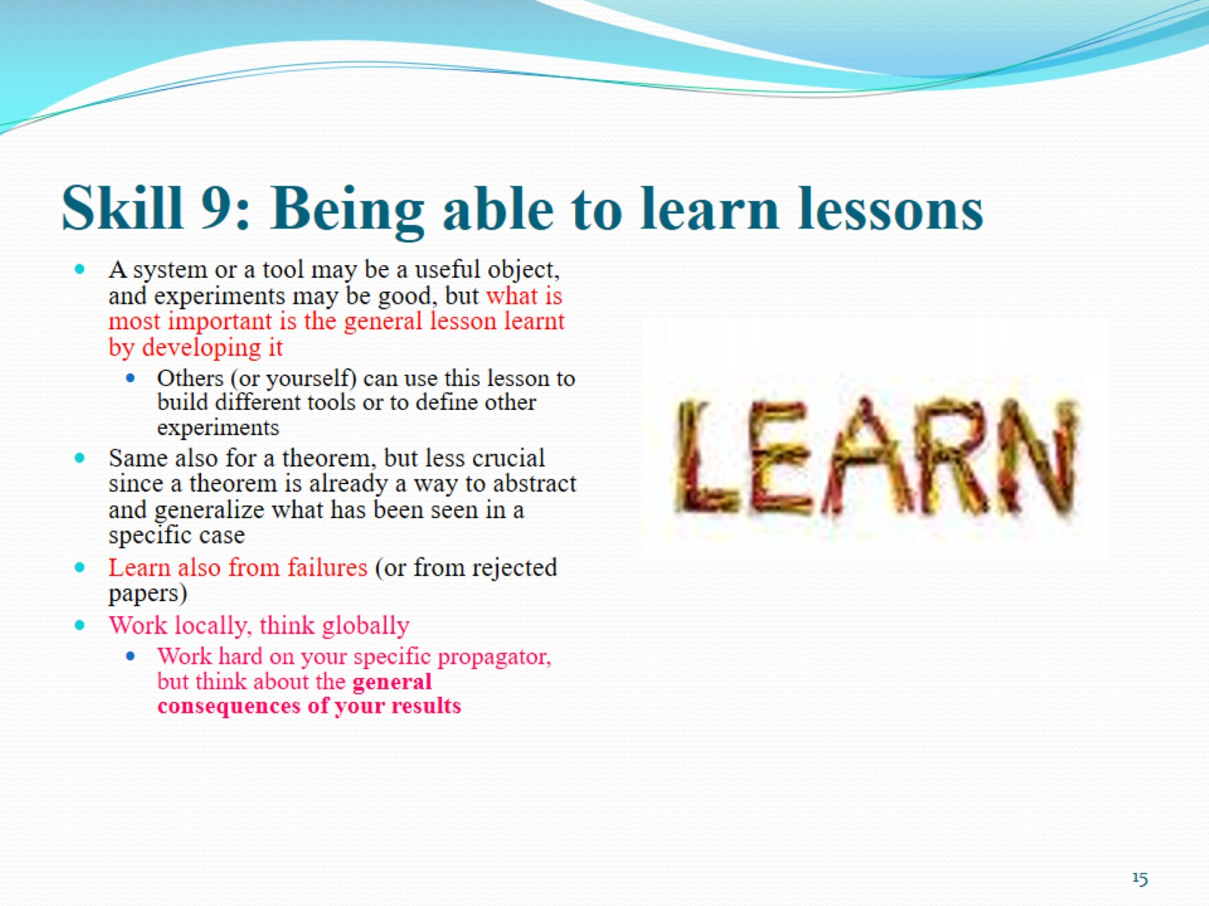
Skill 9: Being able to learn lessons

Slide 16
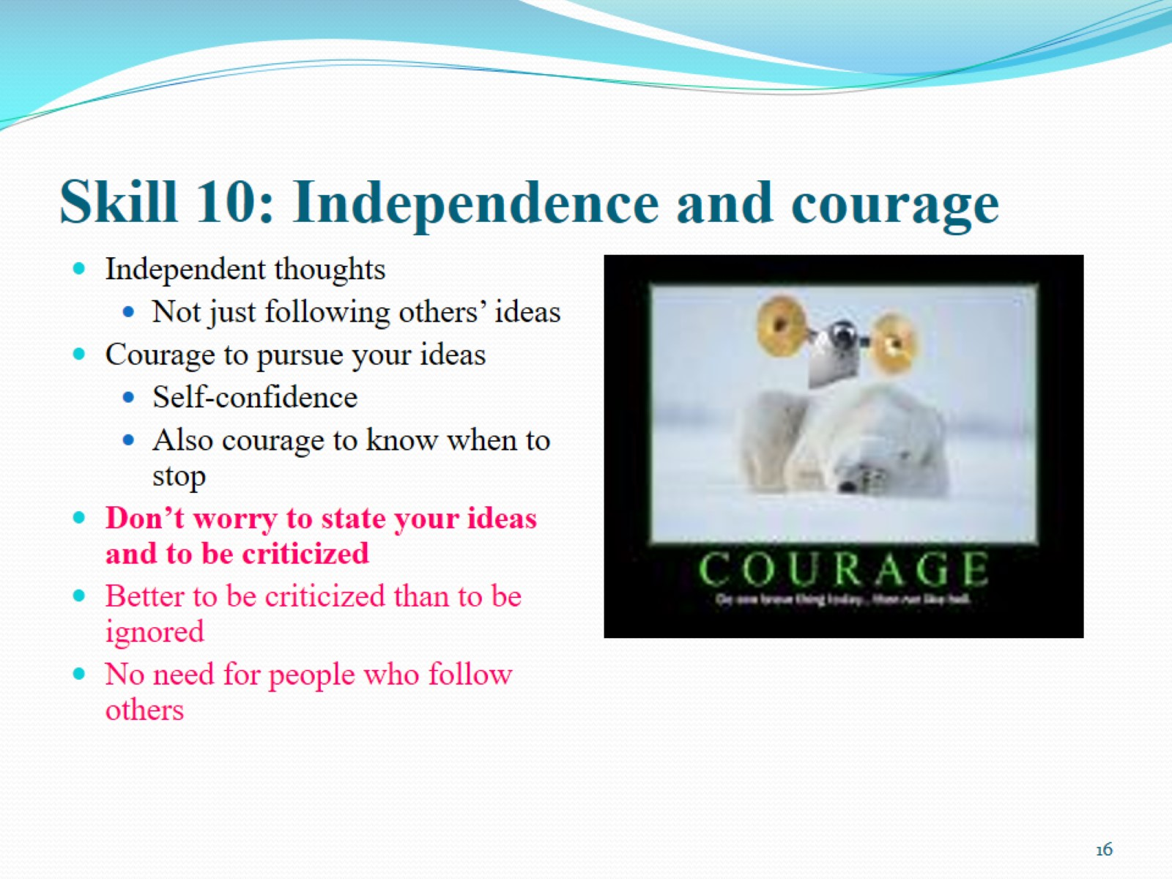
Skill 10: Independence and courage

Slide 17
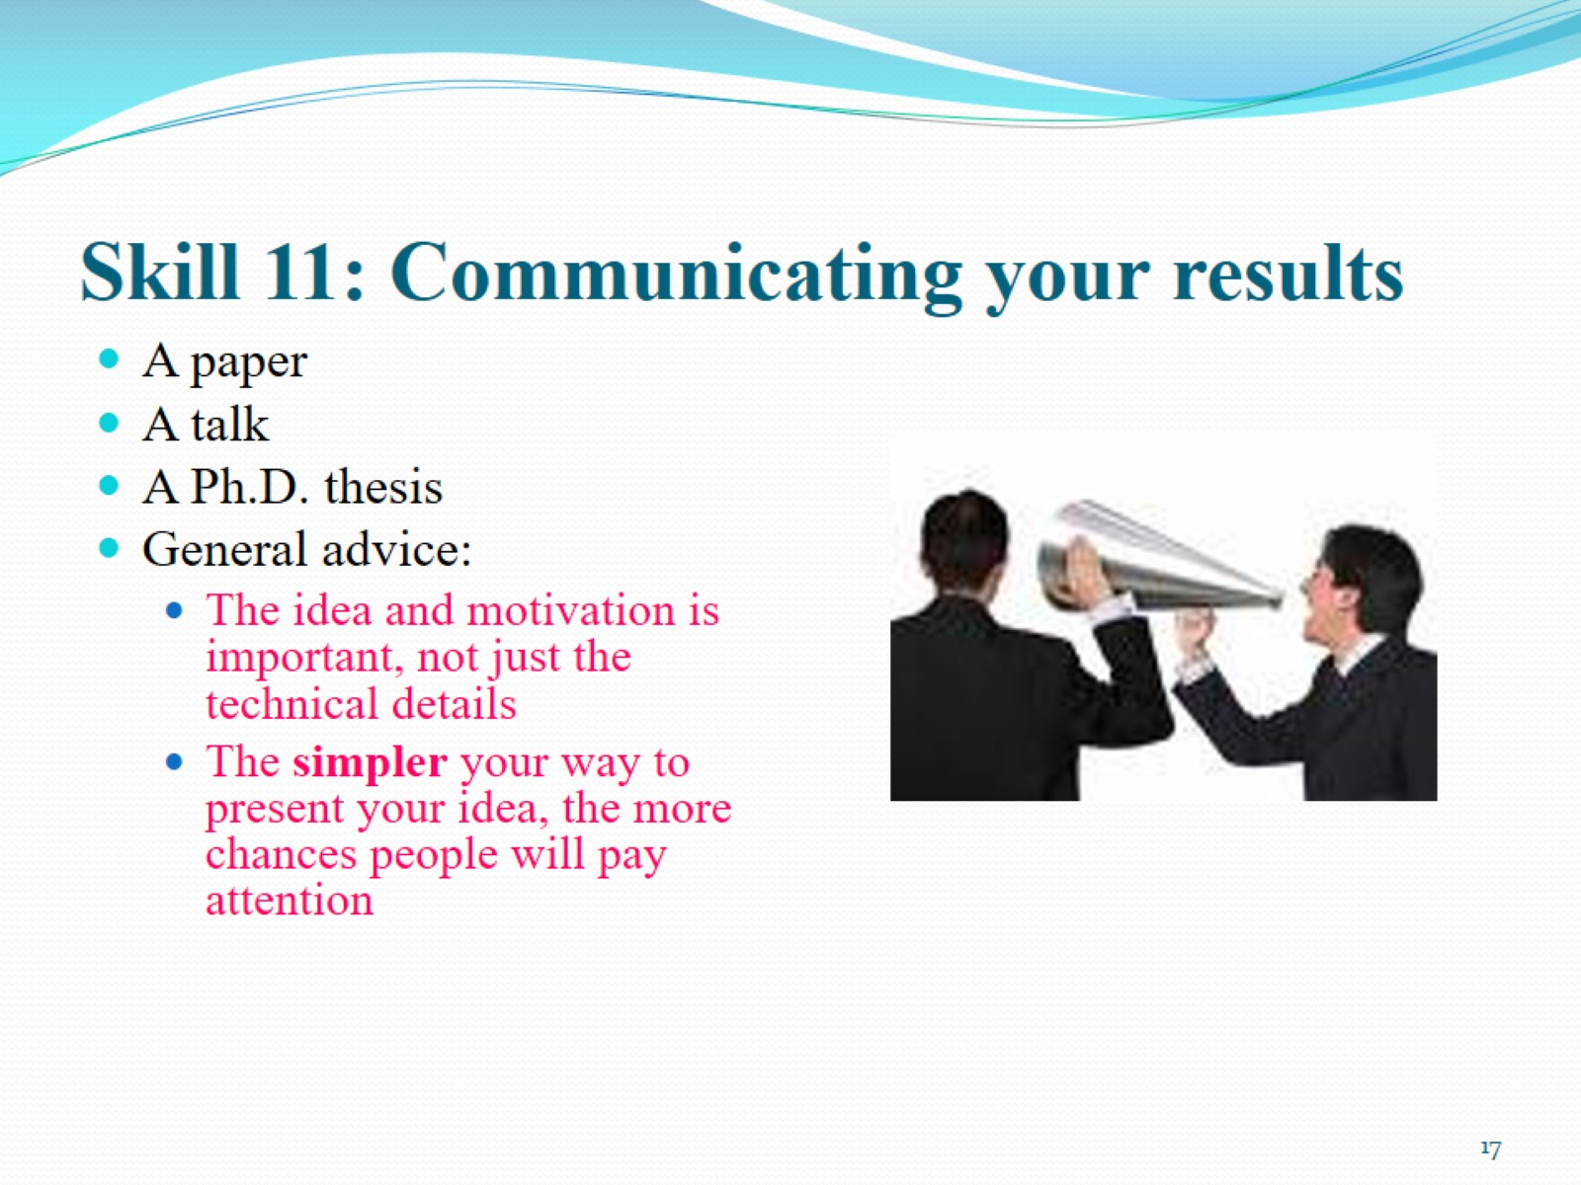
Skill 11: Communicating your results

Slide 18
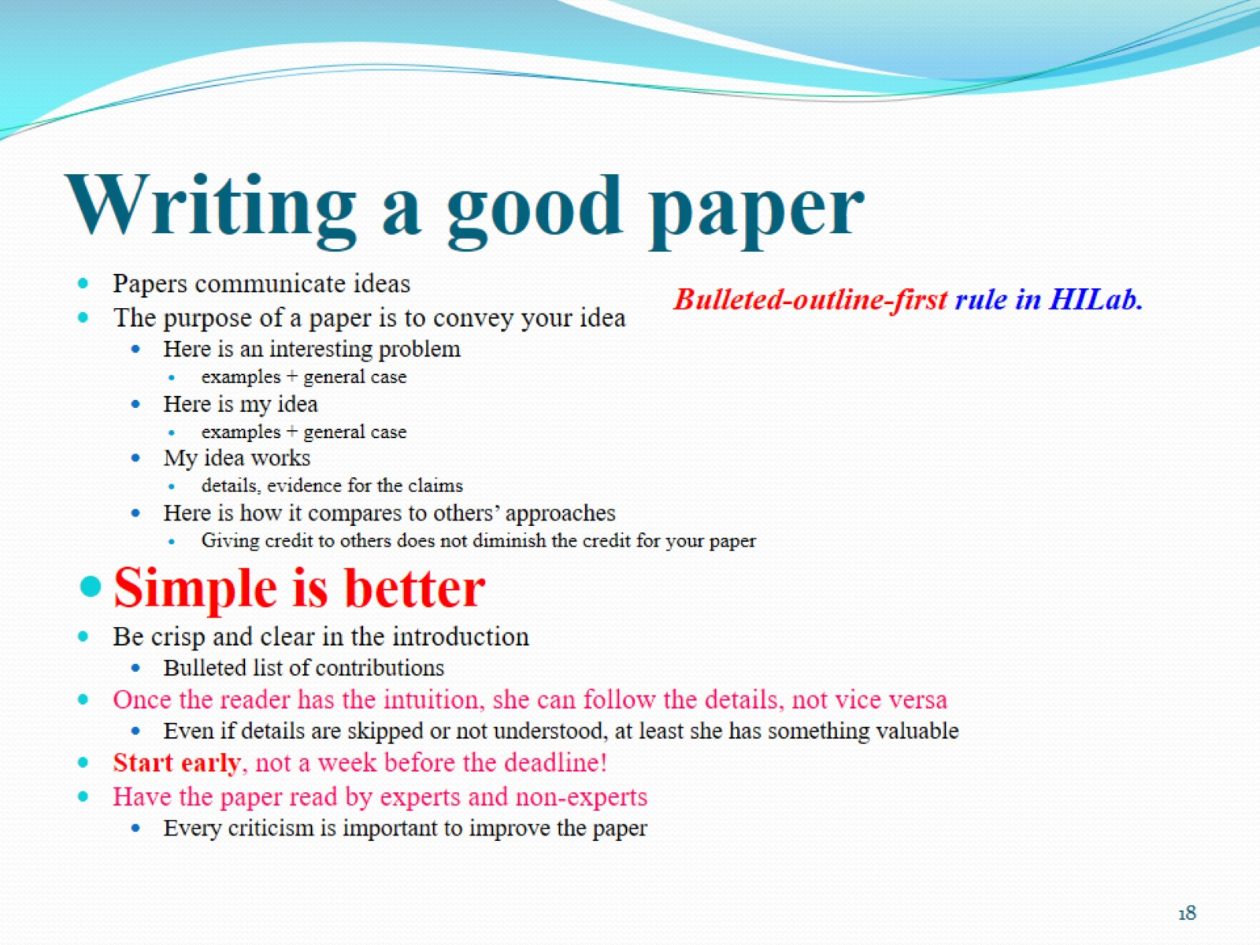
Writing a good paper

Slide 19
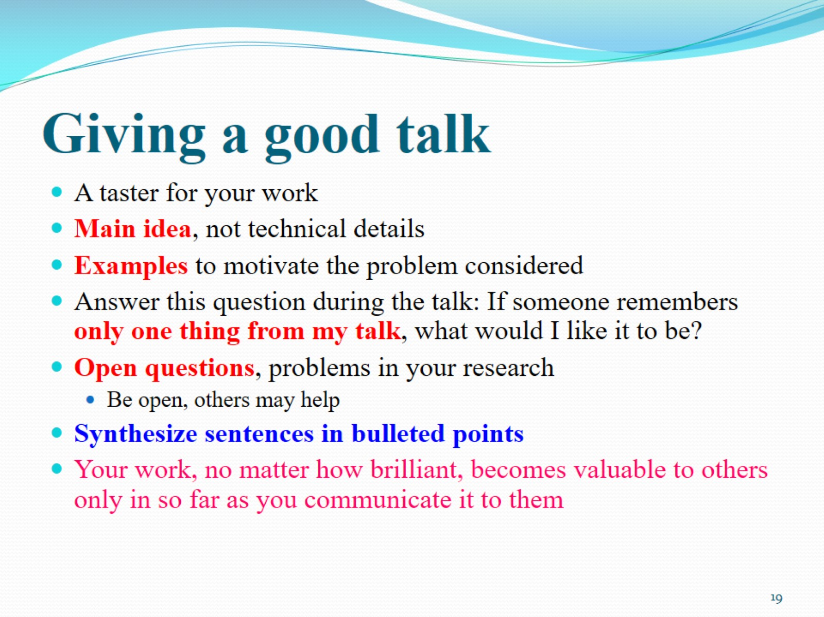
Giving a good talk

Slide 20
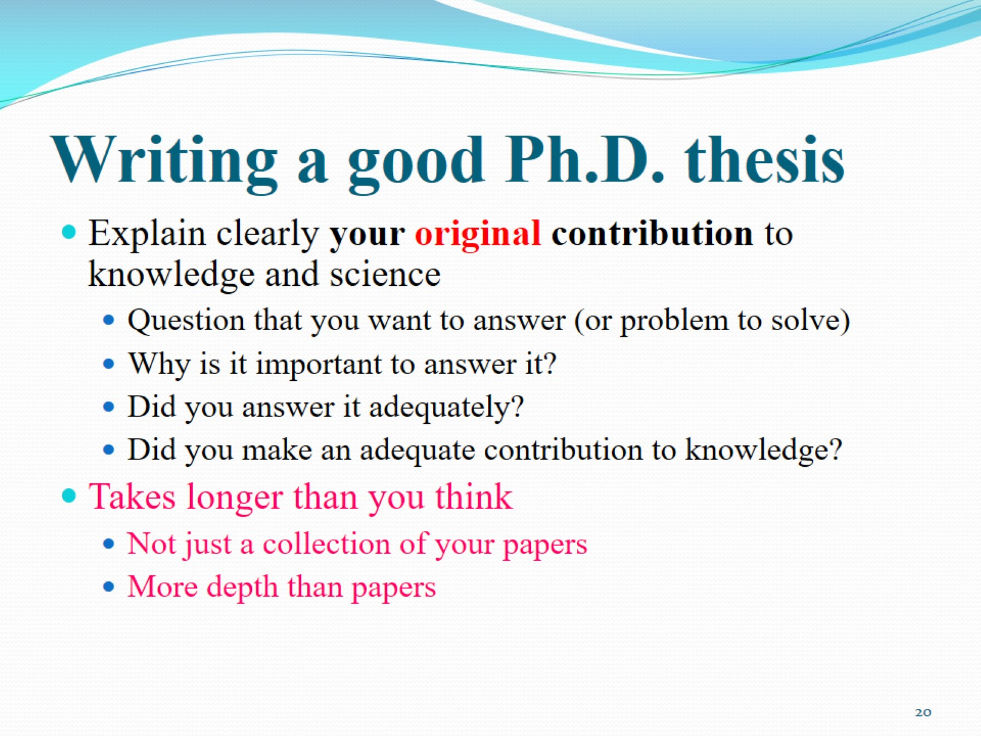
Writing a good Ph.D. thesis

Slide 21
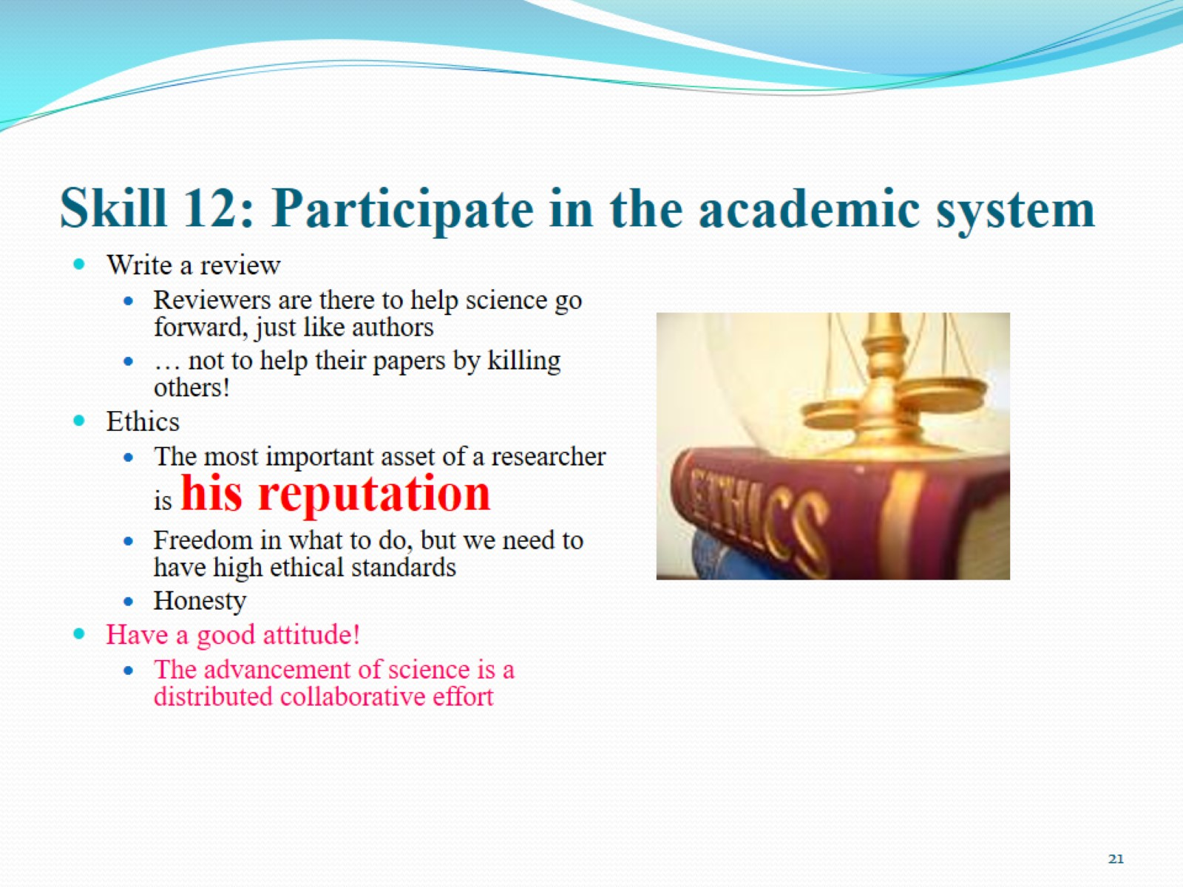
Skill 12: Participate in the academic system

Slide 22
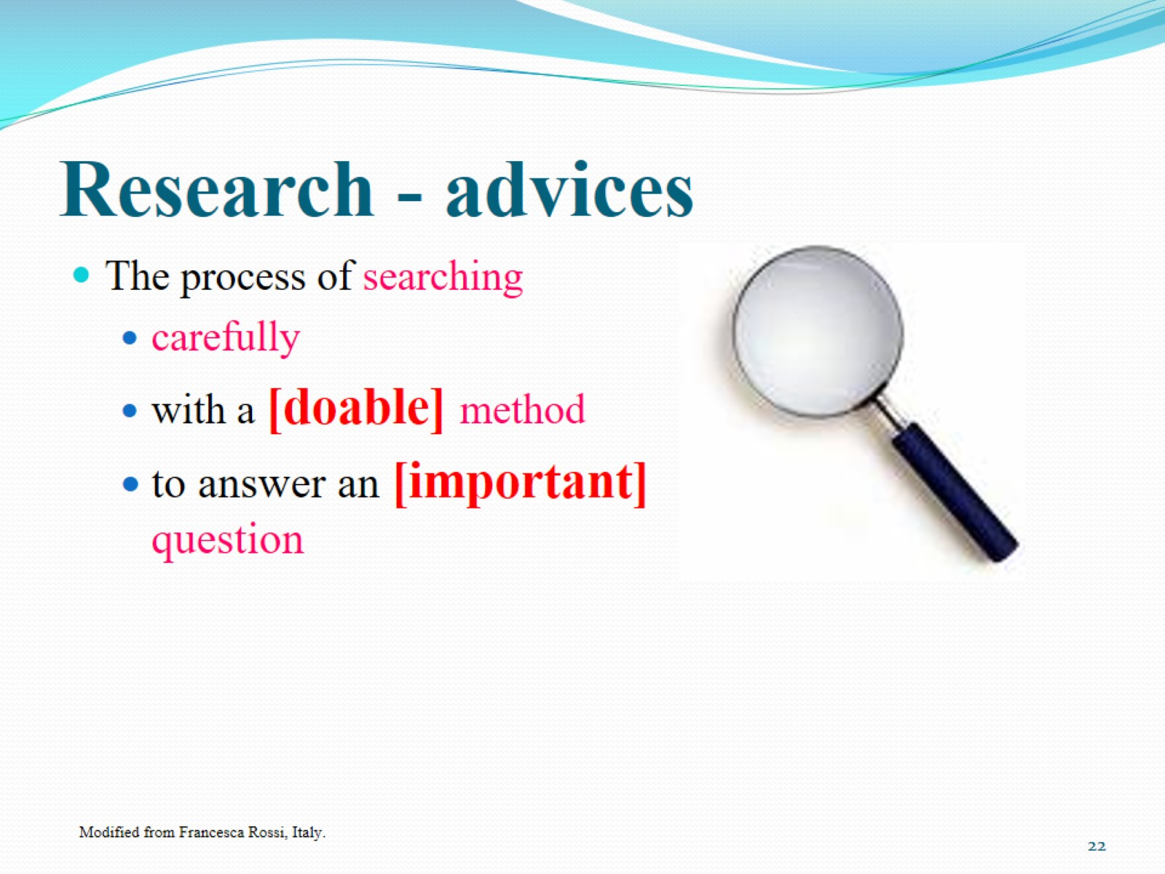
Research - advices

Slide 23
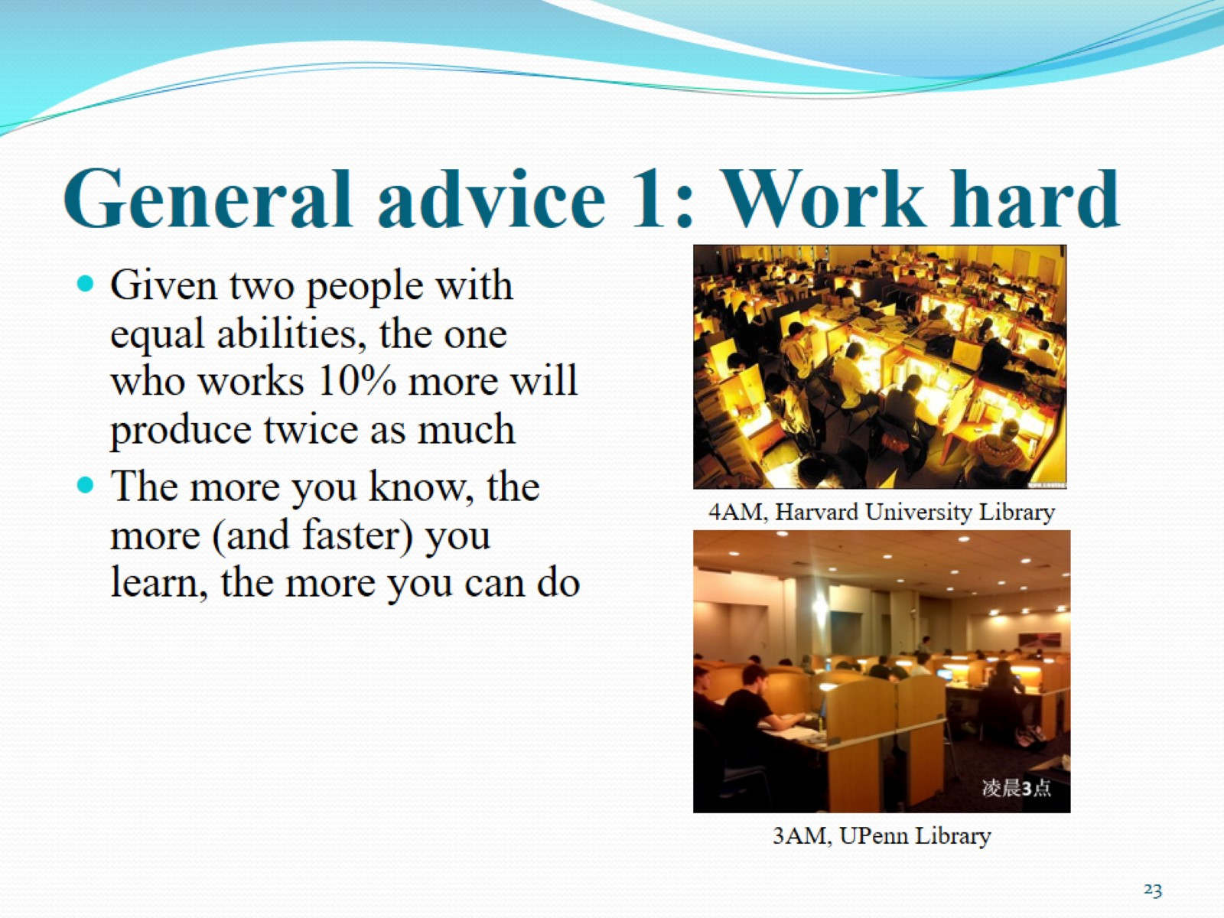
General advice 1: Work hard

Slide 24
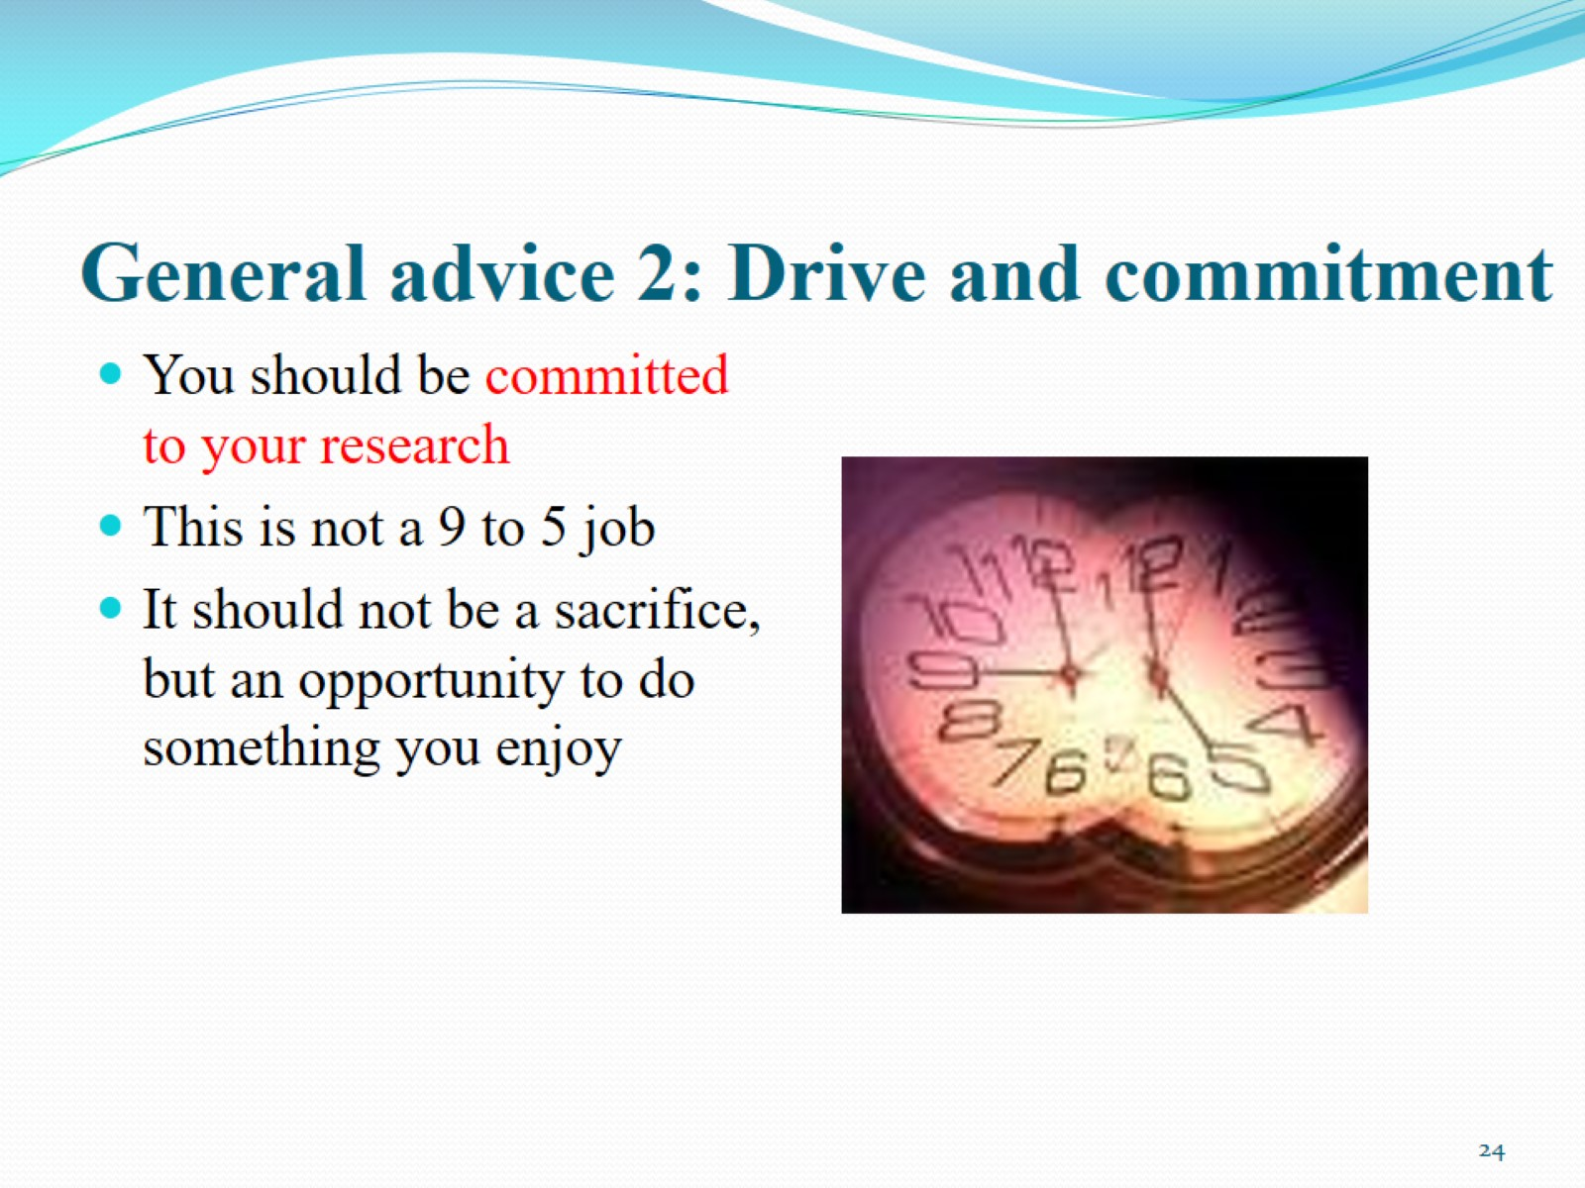
General advice 2: Drive and commitment

Slide 25
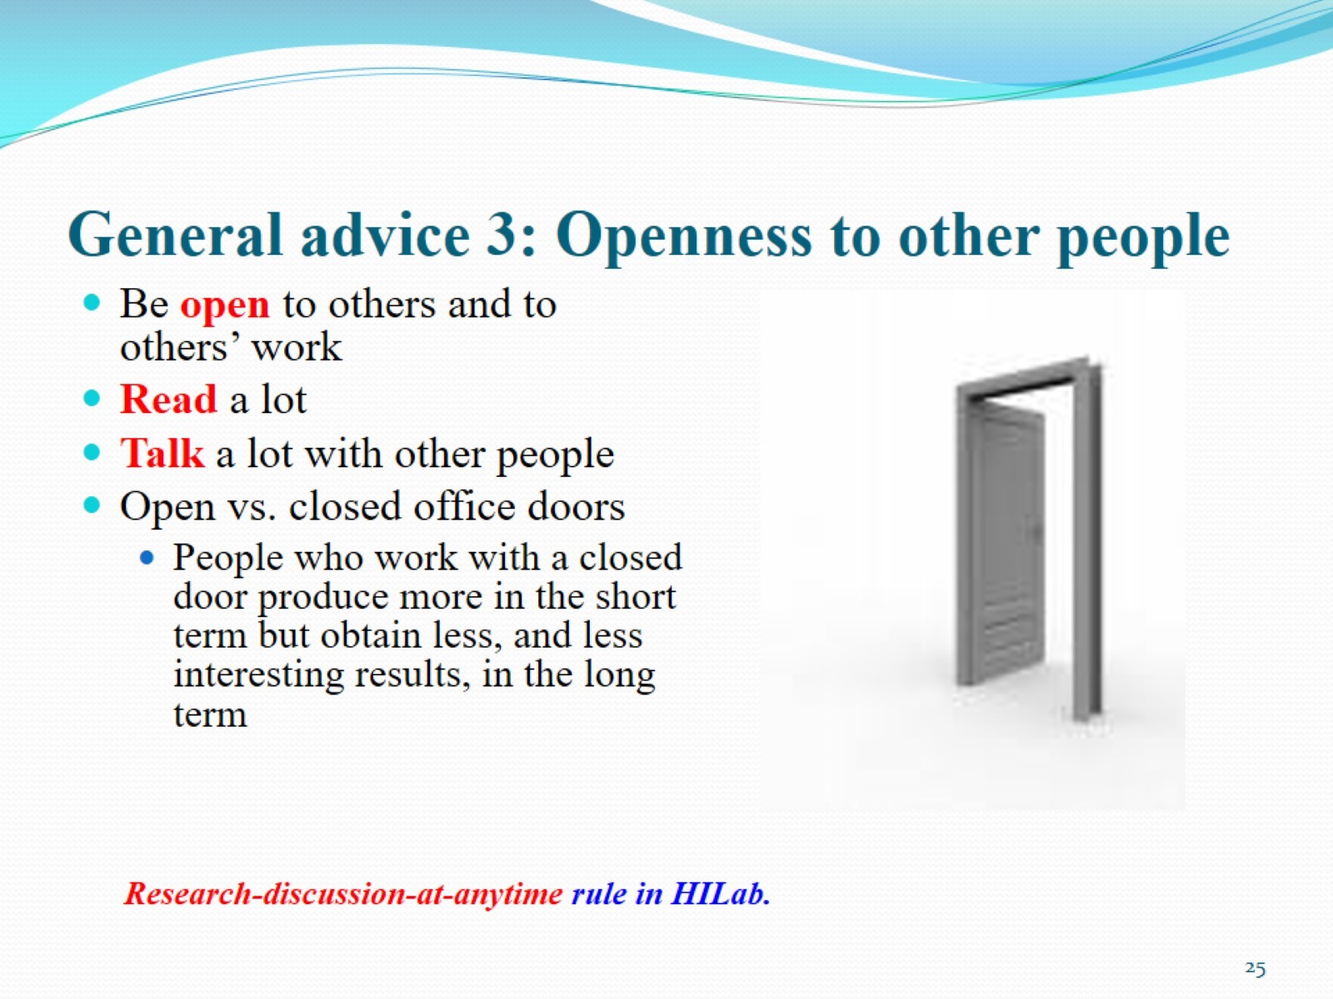
General advice 3: Openness to other people

Slide 26
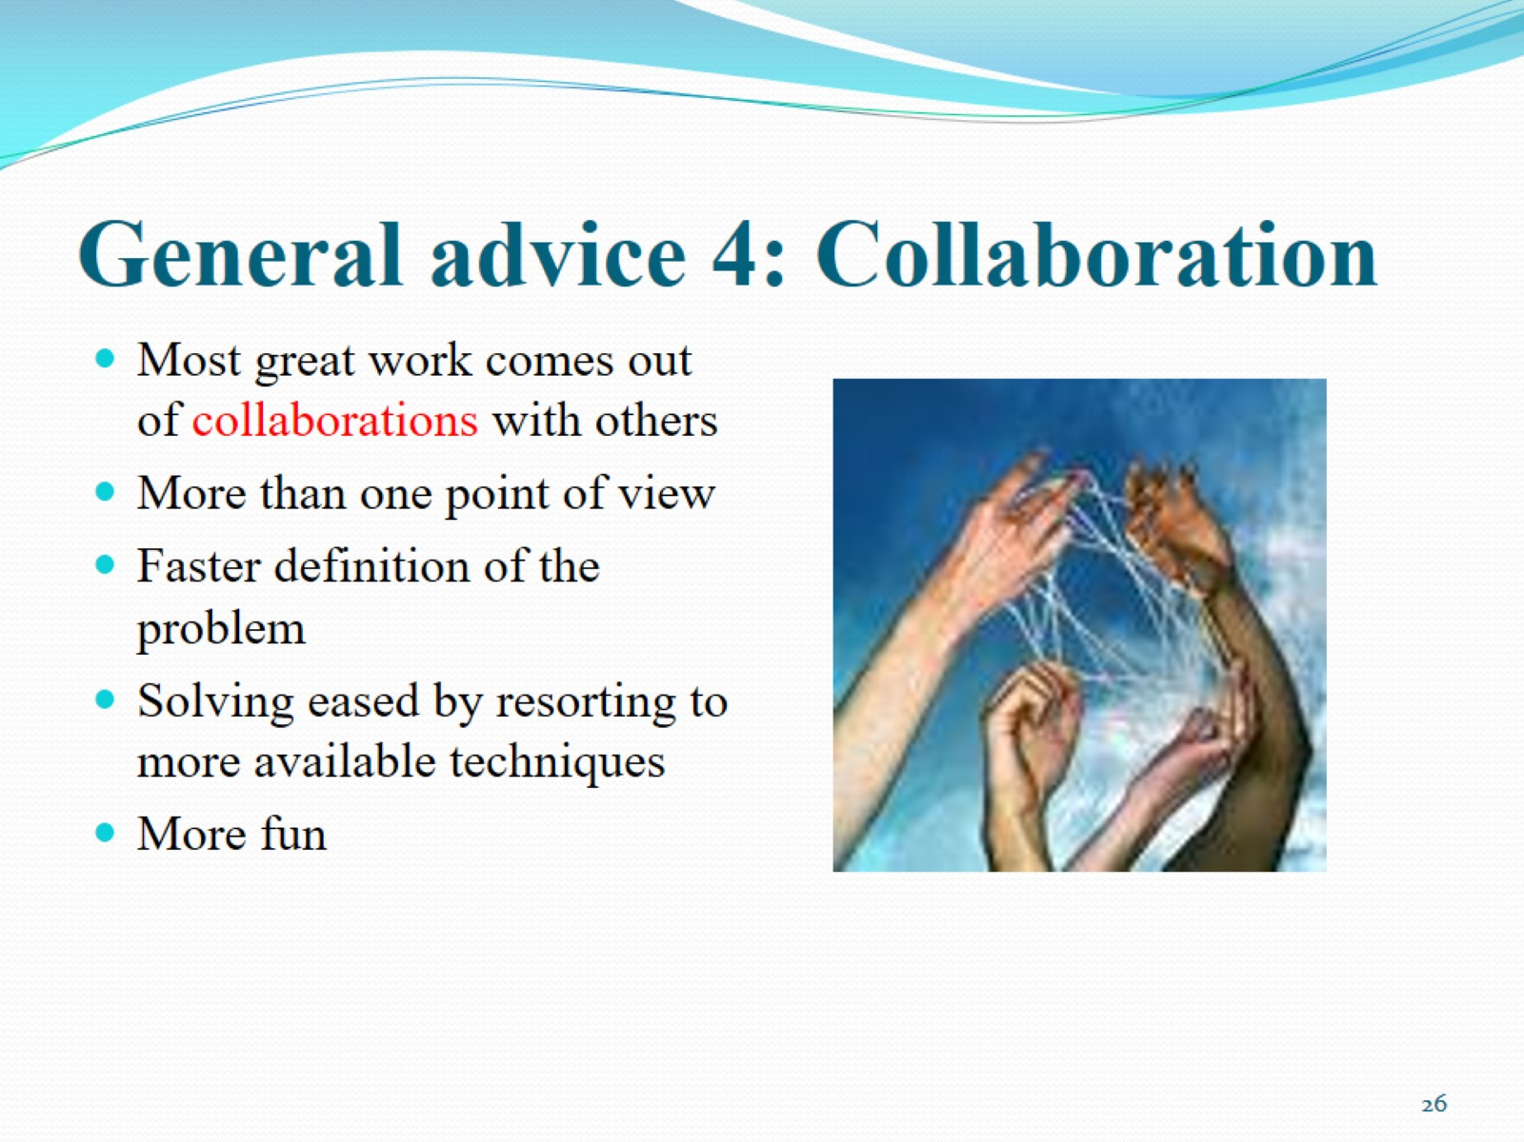
General advice 4: Collaboration

Slide 27
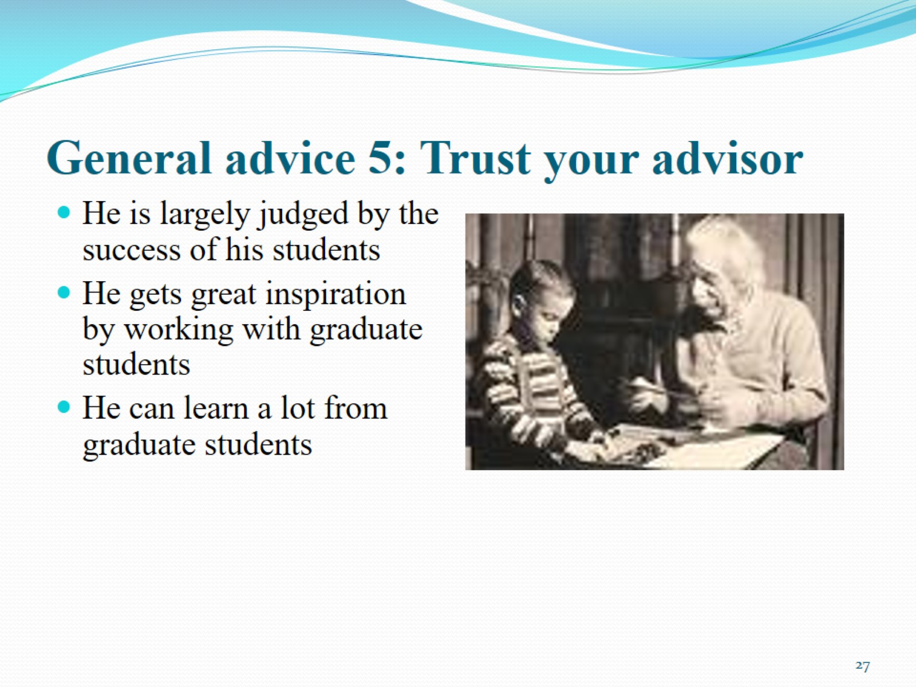
General advice 5: Trust your advisor

Slide 28
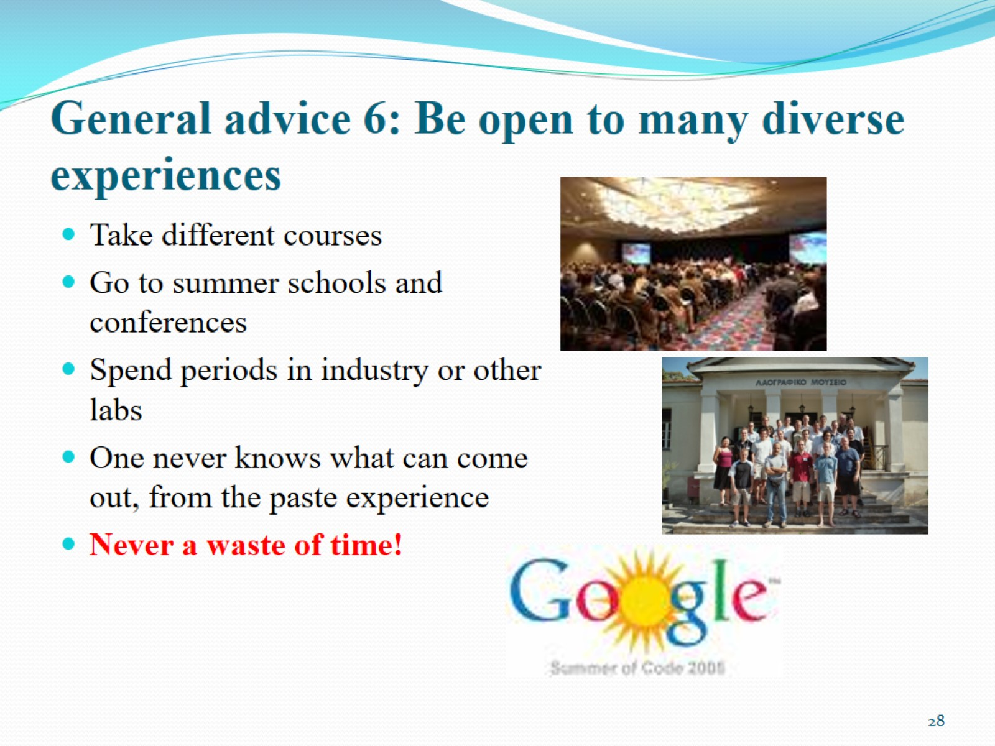
General advice 6: Be open to many diverse experiences

Slide 29
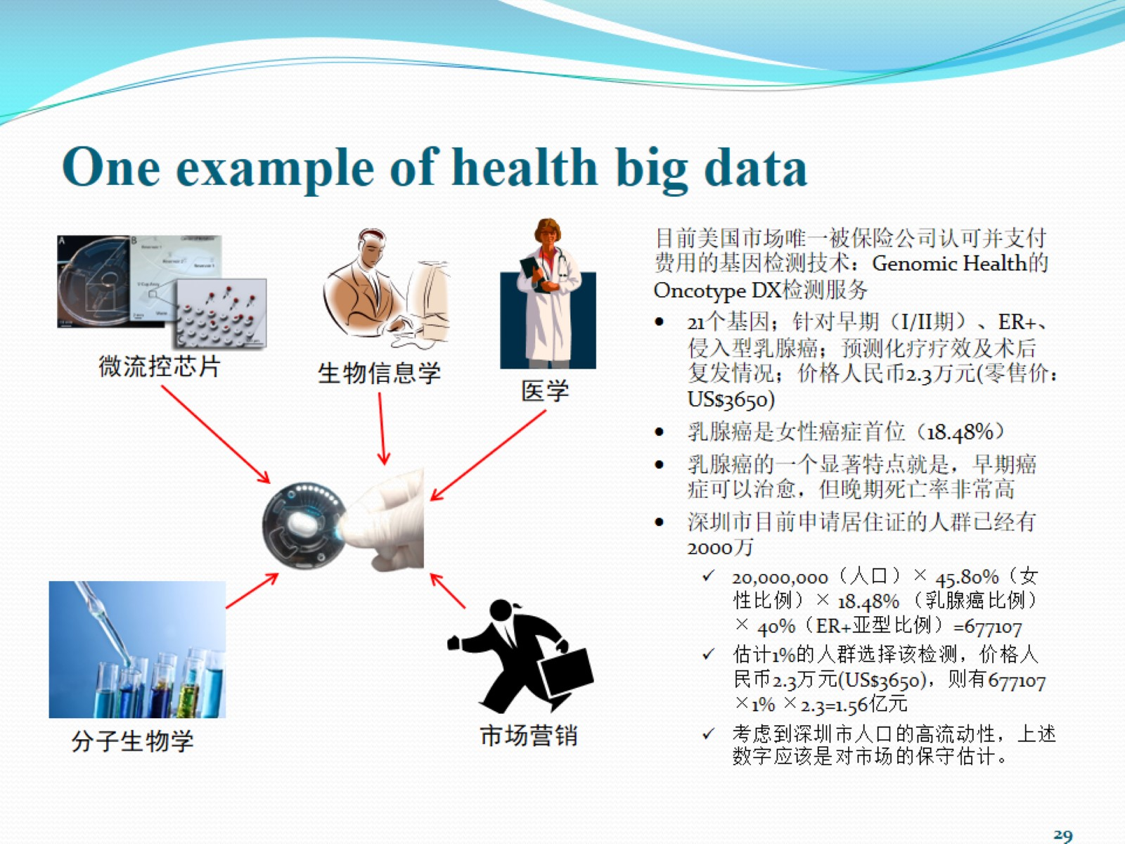

Slide 30
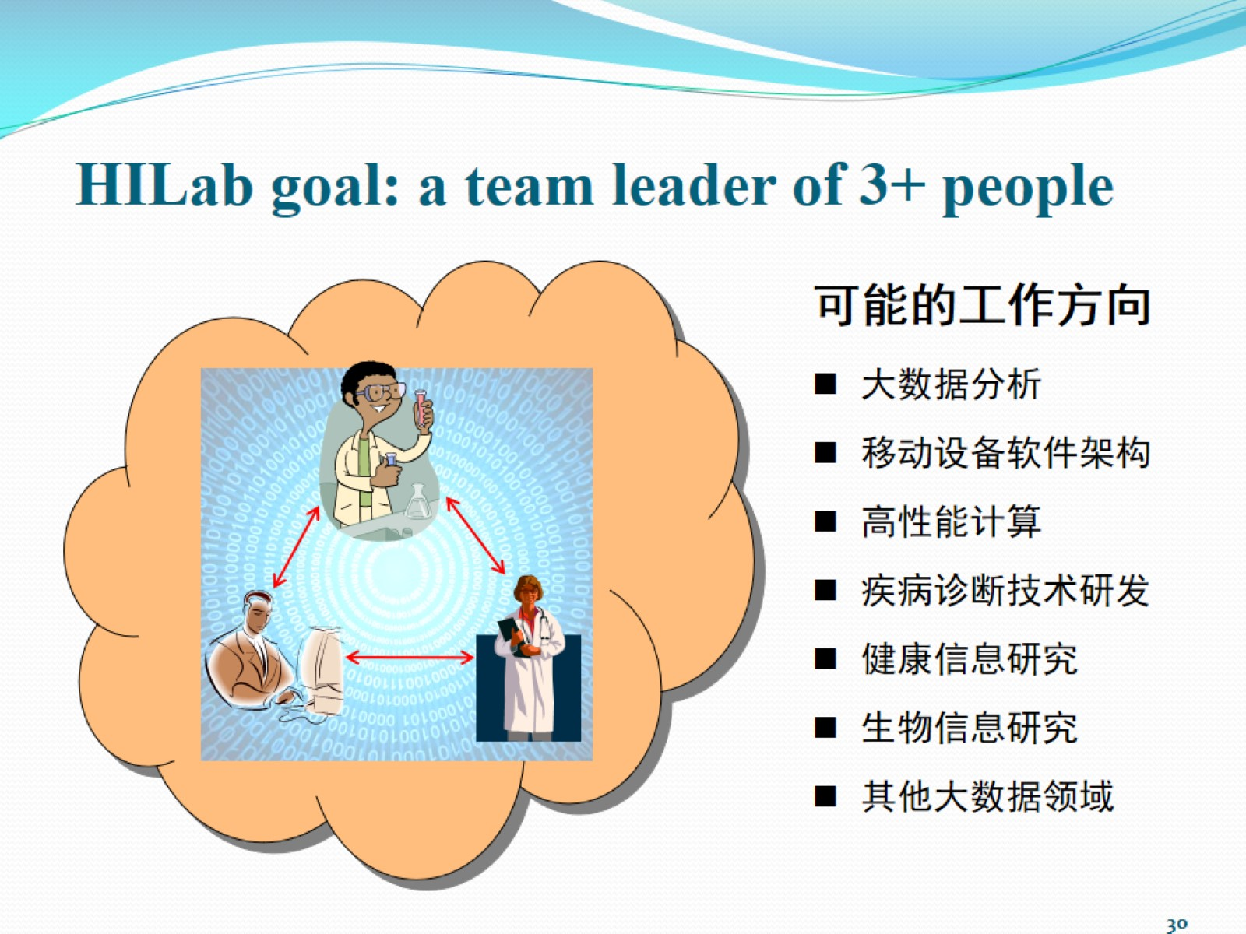

Slide 31
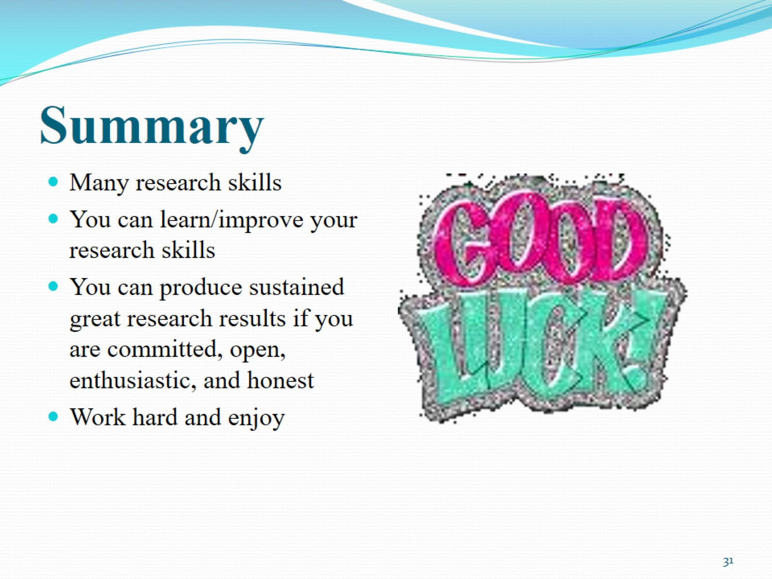
Summary

Slide 32
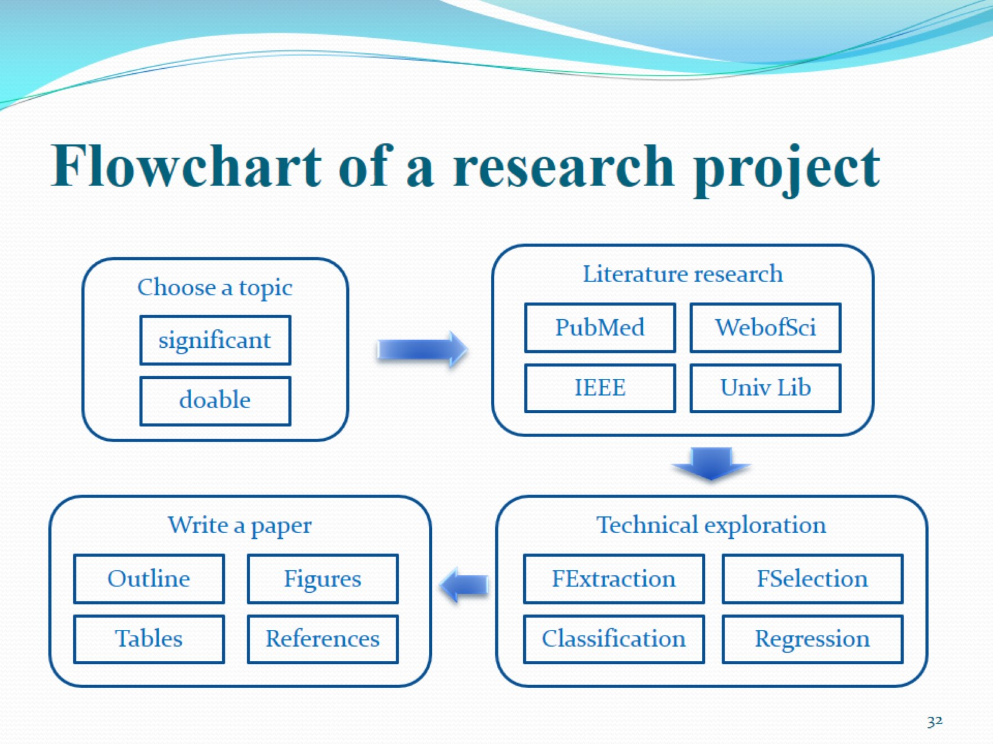
Flowchart of a research project

Slide 33
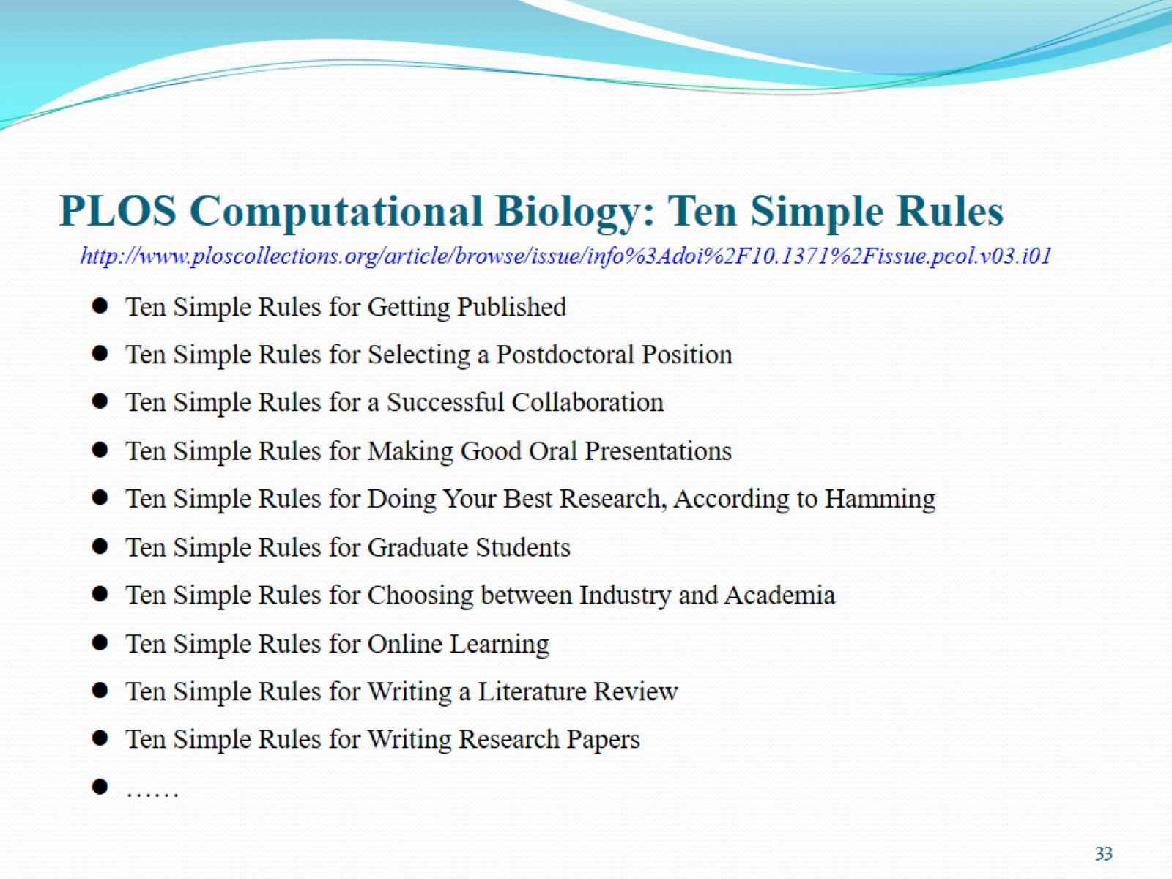
PLOS Computational Biology: Ten Simple Rules

